Slide 1
Lessons on a SIF Definition Journey
SIF Workshop
May 27, 2026

Slide 2
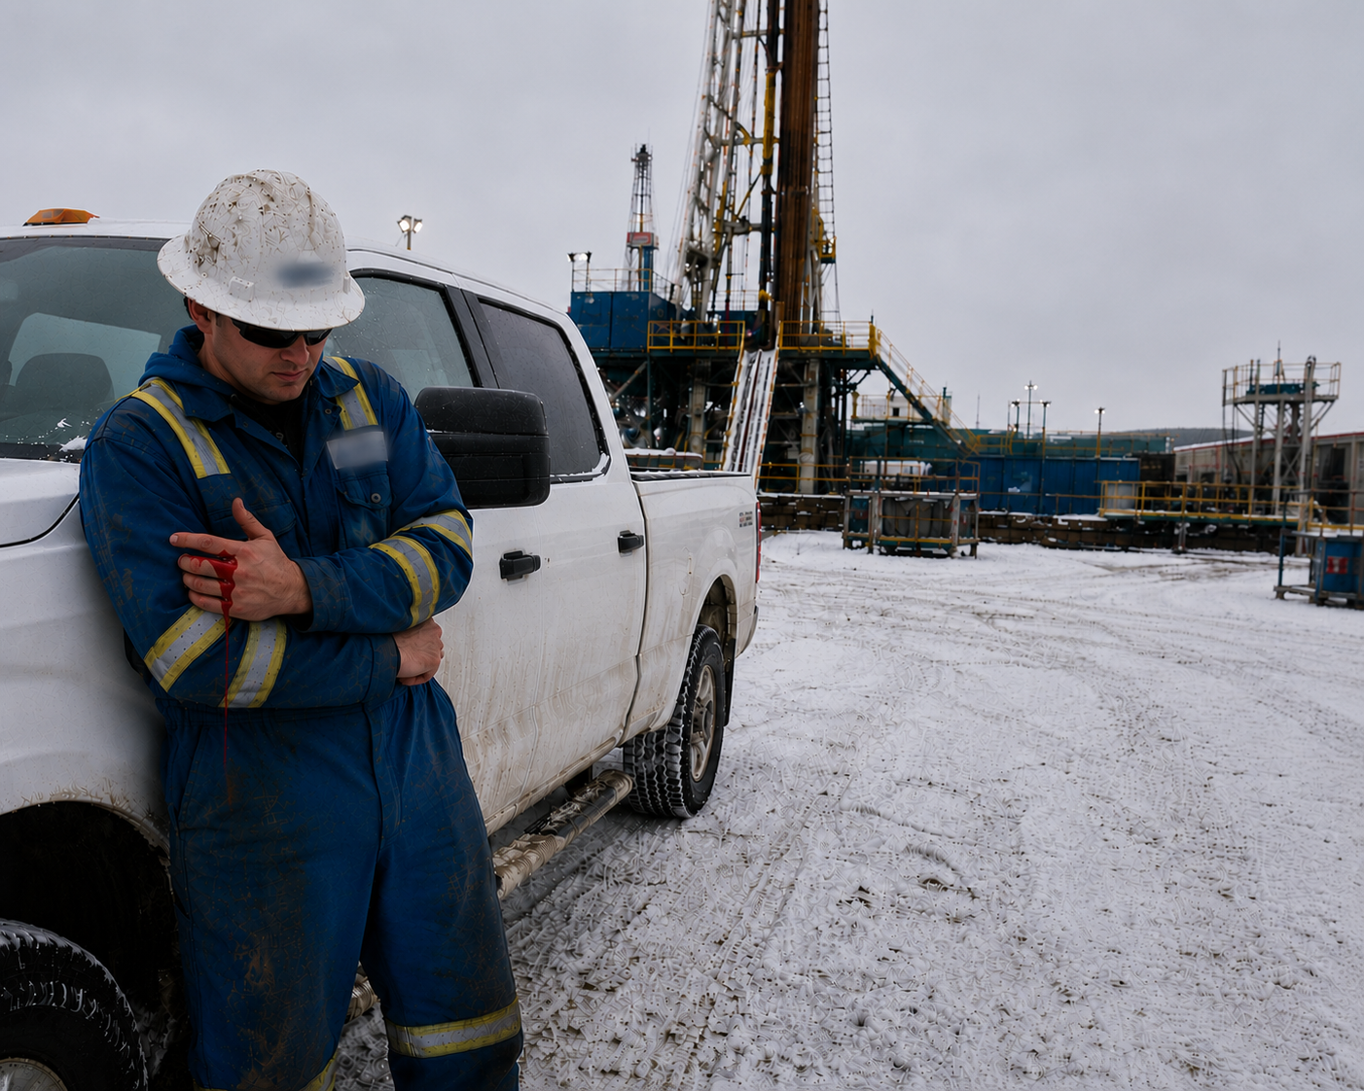
Story for Reflection | Group Activity
A rig manager crushes their finger in the pick-up truck’s door, and the fix was impact-resistant gloves for all workers that drive, enter or exit vehicles.
The company spends $75,000 on gloves (money originally budgeted for critical-risk management).
Is this a serious injury?
Is this good risk management?
How is the system driving this action?
2
Notes:
Provide the story and then have a discussion as a group in answering these questions?

Slide 3
Agenda
A Case Study of what Canadian O&G just did on SIF.
The Problem: Why SIF Needs a Different Approach?
Defining SIF: The Necessary Starting Point (Not the End Goal)
The Data Reality: Why Learning is Hard?
Unlocking Prevention: From SIF to SIF-P and Leading Indicators
System Effects and the Path Forward (ESC Roadmap)
3
Notes:
Life-threatening - Qualified person confirms that Injured person would not have survived without immediate medical intervention or life-saving support (e.g., CPR, defibrillation). f1bayona_0923.pdf
Life-Altering - Qualified person confirms that IP will not fully recover and will most likely suffer permanent impairment from the loss of the use of a major internal organ (i.e., brain, heart,
lungs, liver, and kidneys), body function, or body part. They define body function as: Physiological and psychological functions of body systems. Examples include vision, range
of motion, or spatial orientation. They define body parts as: anatomical parts of the body, such as organs, limbs, and their components, that support body functions. Examples include eyes or hands.
IOGP’ defines permanent impairment as the outcome of a work-related injury from which the worker cannot or is not expected to return to their previous whole function as a result of a single incident, resulting in any of the following: permanent loss of body parts, permanent reduction of organ’s psychological function, permanent reduction in skin and musculoskeletal function and permanent reduction in psychological, social or cognitive function. IOGP Fatality and Permanent Impairment | IOGP

Slide 4
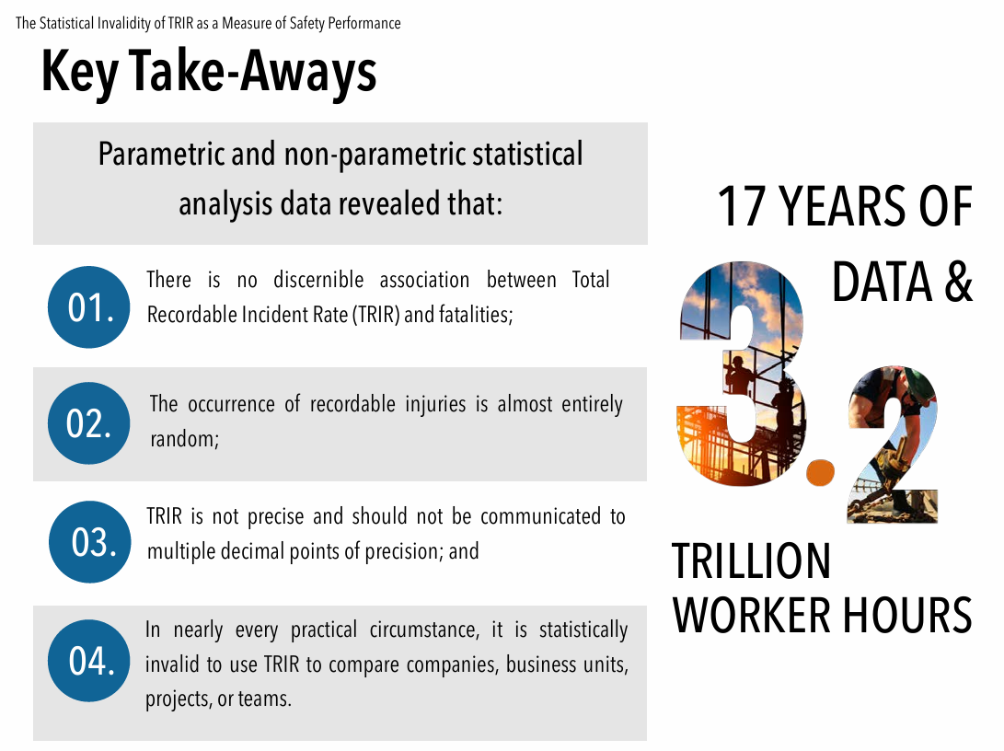
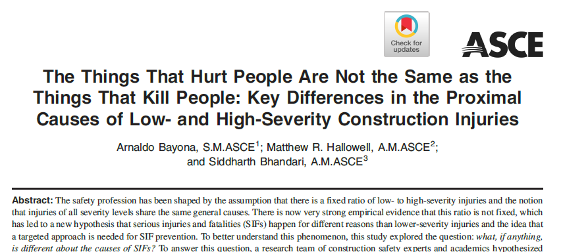
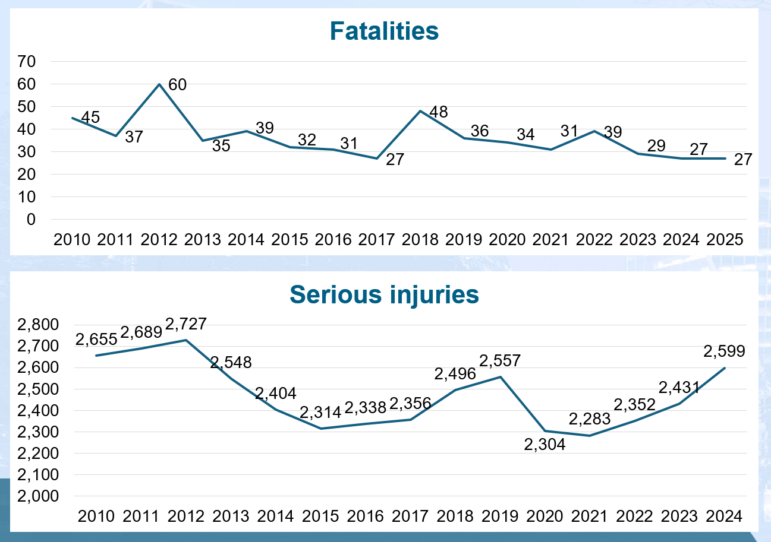

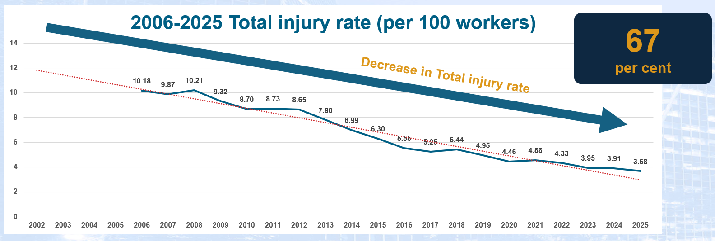
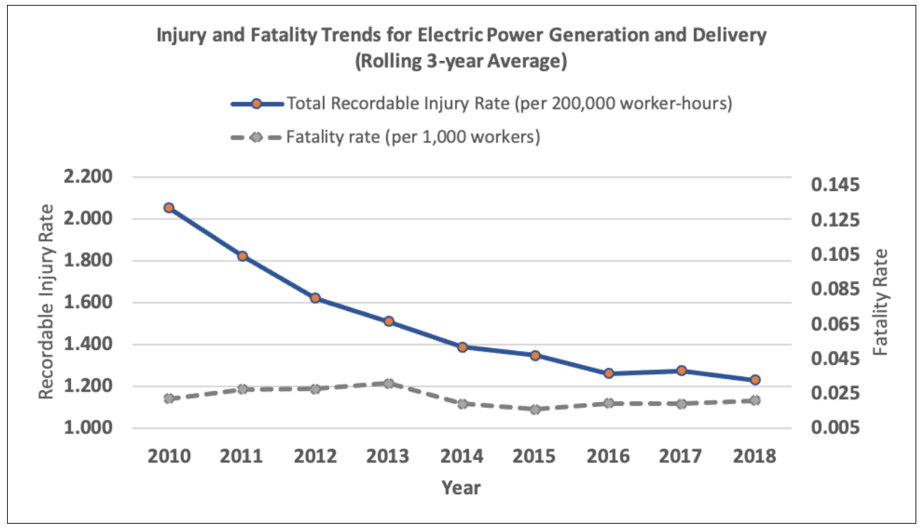
Moving to a SIF-Focused Industry
2023 mining industry data from ICMM shows companies with low TRIF still experience fatalities and worst performers by TRIF have none
4
4

Slide 5
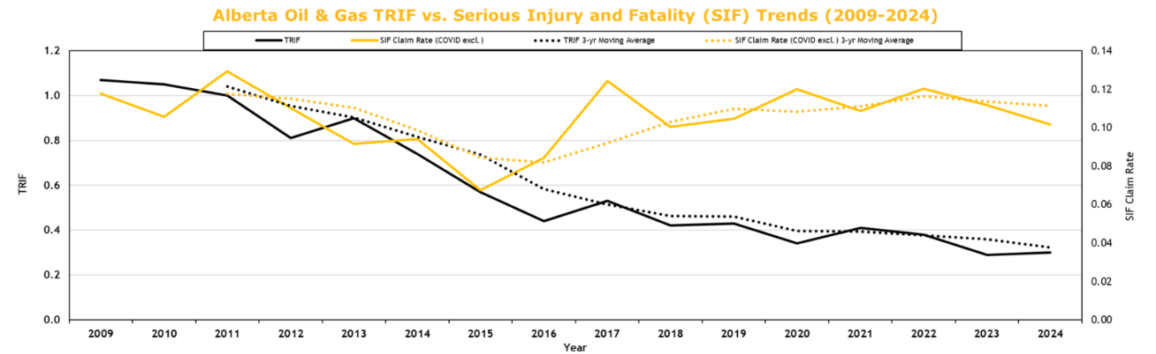
Moving to a SIF-Focused Industry
In Alberta, in 2025:
~9 Fatalities
~125 life-altering incidents
134 Lives. 134 Families.
TRIF Improves, but serious incidents persist
SIF Flatlined
TRIF 70%
Sources: Industry and WCB Alberta data
5
Notes:
Despite a significant decline in industry TRIF over the last 15 years, SIF has stagnated, signaling that a shift to a SIF-driven approach is needed.

Slide 6
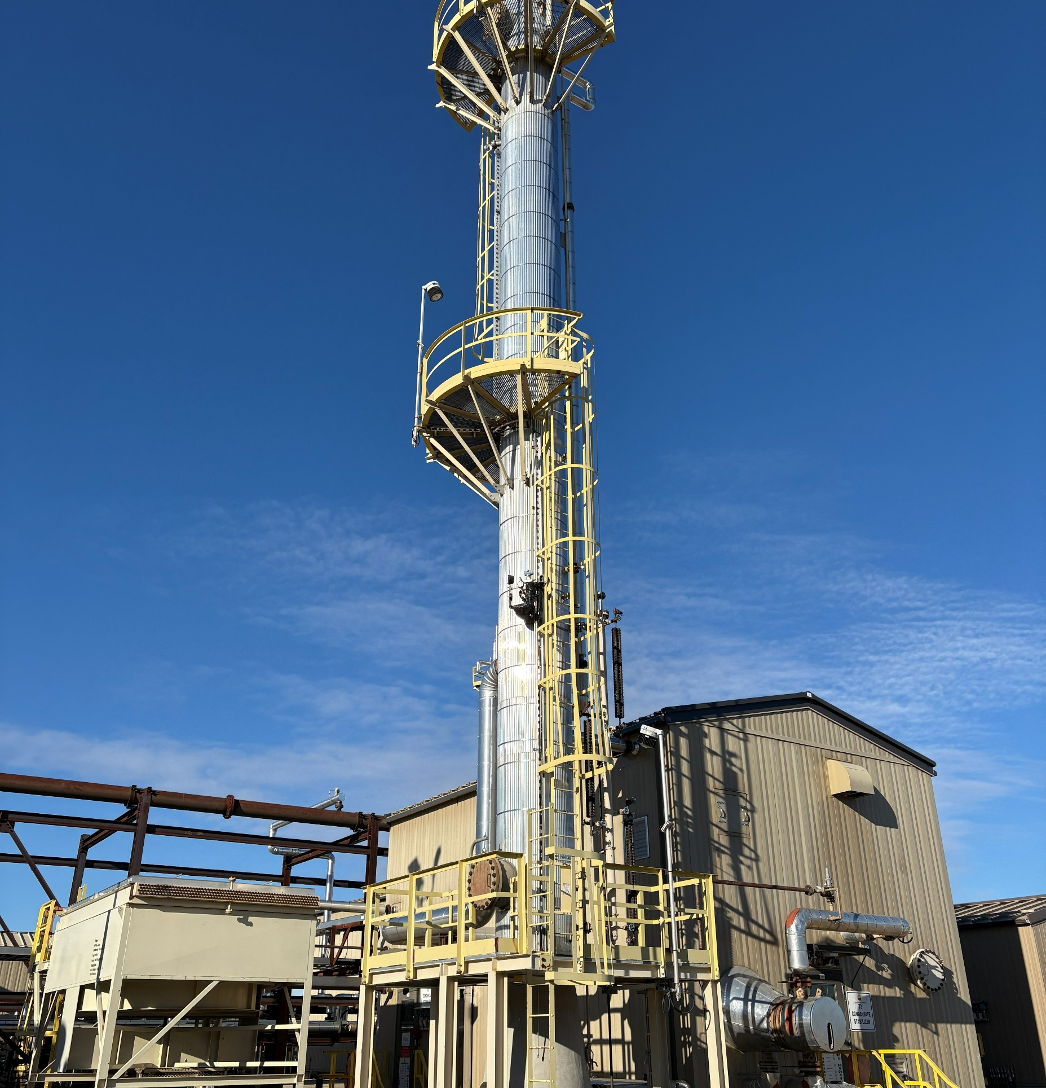
SIF Prevention & System Changes
“We can’t solve problems by using the same kind of thinking we used, when we created them.” Albert Einstein
Industry with fatality-level exposures
  Cannot manage that risk if reliant on TRIR
  Must create a “SIF-tuned” strategy
  Trying harder will not get us there!
For us this is both a
  Fiscal imperative
  Moral imperative
6
Notes:
Life-threatening - Qualified person confirms that Injured person would not have survived without immediate medical intervention or life-saving support (e.g., CPR, defibrillation). f1bayona_0923.pdf
Life-Altering - Qualified person confirms that IP will not fully recover and will most likely suffer permanent impairment from the loss of the use of a major internal organ (i.e., brain, heart,
lungs, liver, and kidneys), body function, or body part. They define body function as: Physiological and psychological functions of body systems. Examples include vision, range
of motion, or spatial orientation. They define body parts as: anatomical parts of the body, such as organs, limbs, and their components, that support body functions. Examples include eyes or hands.
IOGP’ defines permanent impairment as the outcome of a work-related injury from which the worker cannot or is not expected to return to their previous whole function as a result of a single incident, resulting in any of the following: permanent loss of body parts, permanent reduction of organ’s psychological function, permanent reduction in skin and musculoskeletal function and permanent reduction in psychological, social or cognitive function. IOGP Fatality and Permanent Impairment | IOGP

Slide 7
ESC Case Study | SIF Definition
ESC Activities:
8 meetings, 5 weeks with 49 people, 30+ companies
This is not about doing more!
Refocusing efforts on Serious Injury and Fatality (SIF) prevention
That requires careful re-prioritization
ESC SIF Roadmap
SIF Def
SIF Metrics
SIF Sharing, Learning & Prevention
7

Slide 8

Existing Data (2023-2025)
Comparative Analysis
Top 3 Incidents by Type
PSI (AB OH&S) | AB OH&S Serious Incident Notification | Serious Incidents (WCB 50+ days) | Fatalities
Struck/Contact with Objects | Struck/Contact with Objects | Bodily Reaction/Overexertion | Vehicle/Transportation
Vehicle/Transportation | Fire/Explosion | Falls - Same Level | Chemical/Substance Exposure
Chemical/Substance Exposure | Falls - Same Level | Struck/Contact with Objects | Struck/Contact with Objects
Struck/Contact with Objects (Line of Fire) is a pervasive risk across all data sets
Vehicle/Transportation and Chemical/Substance Exposure are less frequent but higher
fatal consequences (less recoverable)
Bodily Reaction/Overexertion and Falls - Same Level are common and major contributors
to lost time and cost but rarely lead to fatalities
These differences reflect different cuts of reality and the need for a common definition of serious injury and industry data to improve the resolution of the picture.
Sources: WCB Alberta and Alberta OH&S data.
8
Notes:
[These speaking notes are misplaced]
Life-threatening - Qualified person confirms that Injured person would not have survived without immediate medical intervention or life-saving support (e.g., CPR, defibrillation). f1bayona_0923.pdf
Life-Altering - Qualified person confirms that IP will not fully recover and will most likely suffer permanent impairment from the loss of the use of a major internal organ (i.e., brain, heart,
lungs, liver, and kidneys), body function, or body part. They define body function as: Physiological and psychological functions of body systems. Examples include vision, range
of motion, or spatial orientation. They define body parts as: anatomical parts of the body, such as organs, limbs, and their components, that support body functions. Examples include eyes or hands.
IOGP’ defines permanent impairment as the outcome of a work-related injury from which the worker cannot or is not expected to return to their previous whole function as a result of a single incident, resulting in any of the following: permanent loss of body parts, permanent reduction of organ’s psychological function, permanent reduction in skin and musculoskeletal function and permanent reduction in psychological, social or cognitive function. IOGP Fatality and Permanent Impairment | IOGP
[Suggested speaking notes for this slide]:
When we compare the top three incident types by source across our data sources (PSI, AB OH&S Serious Incident Notifications, Serious Incidents based on 50+ lost days, and Fatalities), three patterns emerge:
- Struck/Contact with Objects (Line of Fire) is a pervasive risk, consistently appearing across all datasets.
- Vehicle/Transportation and Chemical/Substance Exposures occur less often but drives higher fatal consequences.
Bodily Reaction/Overexertion and Falls on the Same Level are frequent and major contributors to lost time and cost, though these incident types rarely lead to fatalities.
Taken together, these differences reflect how each dataset captures a different slice of reality—reinforcing the need for a common definition of SIF and broader industry data to sharpen our overall view.

Slide 9
SIF Examples | Group Activity
Case Examples – What is SIF?
Example #1: An employee is admitted to hospital with a puncture wound to the abdomen. They undergo exploratory surgery, are stitched and kept for two days for observation. They fully recover with no impairment.
Example #2: An employee is knocked unconscious and is admitted to hospital. They remain in a coma in the Intensive Care Unit for two weeks, after which they awake and are released with no injuries or impairments.
Example #3: An employee tears their shoulder while lifting a valve and returns to full duties five months later.
Example #4: An employee is shocked in the workplace, resulting in cardiac arrest. Site personnel use an AED to restart the worker’s heart and they fully recover.
Is this SIF?
% Yes
##
##
##
##
9
Notes:
Life-threatening - Qualified person confirms that Injured person would not have survived without immediate medical intervention or life-saving support (e.g., CPR, defibrillation). f1bayona_0923.pdf
Life-Altering - Qualified person confirms that IP will not fully recover and will most likely suffer permanent impairment from the loss of the use of a major internal organ (i.e., brain, heart,
lungs, liver, and kidneys), body function, or body part. They define body function as: Physiological and psychological functions of body systems. Examples include vision, range
of motion, or spatial orientation. They define body parts as: anatomical parts of the body, such as organs, limbs, and their components, that support body functions. Examples include eyes or hands.
IOGP’ defines permanent impairment as the outcome of a work-related injury from which the worker cannot or is not expected to return to their previous whole function as a result of a single incident, resulting in any of the following: permanent loss of body parts, permanent reduction of organ’s psychological function, permanent reduction in skin and musculoskeletal function and permanent reduction in psychological, social or cognitive function. IOGP Fatality and Permanent Impairment | IOGP

Slide 10
Priorities | Where is Our Focus?
Fatality? Serious Injury? Both?
What, if any, differences exist between a fatality and serious injury?
  Body part injured?
  Event mechanism?
  Energy level?
How does your definition of a serious injury shape your answer?
*Spoiler Alert: This study suggests that SIF-Actual and SIF-Potential are aligned on proximal causes (i.e., both share proximal causes not evident in low severity injuries).
10

Slide 11
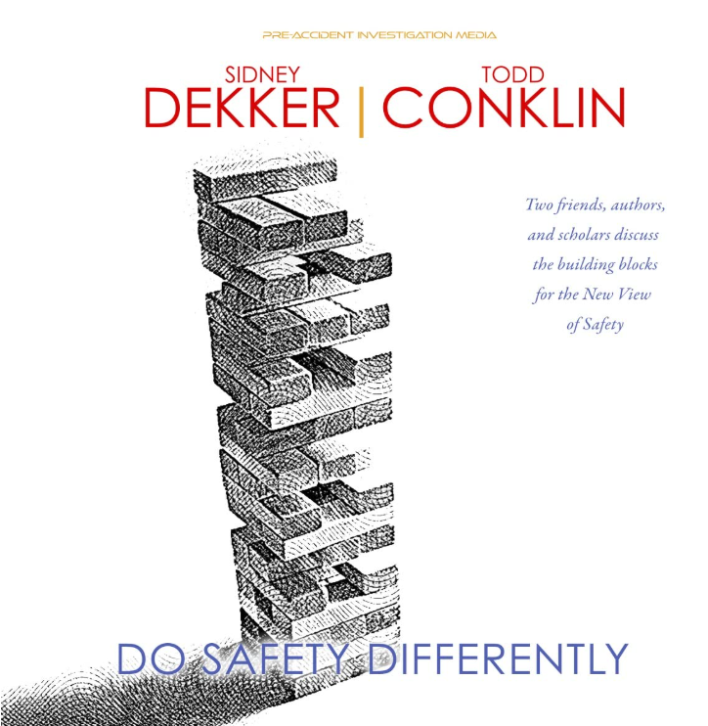
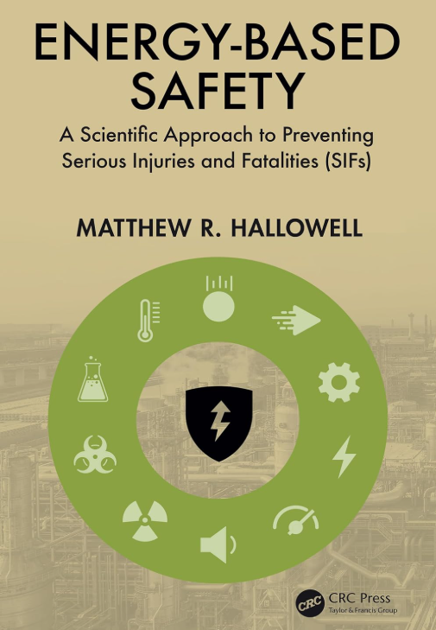
Sidebar | ESC Context (last 6 years)
Energy Based Safety (Hallowell)
HOP (Conklin, Dekker, et al)
CSRA research of 1,000’s of incidents established what many safety professionals knew by instinct—causes/precursors of SIF/non-SIF are different
Improved conceptual framework:
  “High Energy Hazards”
  “Direct Controls”
Context drives behavior
Learning vs Blaming
Work as Imagined vs Work as Done
Workers as problem solvers instead of being the problem
11
Notes:
Life-threatening - Qualified person confirms that Injured person would not have survived without immediate medical intervention or life-saving support (e.g., CPR, defibrillation). f1bayona_0923.pdf
Life-Altering - Qualified person confirms that IP will not fully recover and will most likely suffer permanent impairment from the loss of the use of a major internal organ (i.e., brain, heart,
lungs, liver, and kidneys), body function, or body part. They define body function as: Physiological and psychological functions of body systems. Examples include vision, range
of motion, or spatial orientation. They define body parts as: anatomical parts of the body, such as organs, limbs, and their components, that support body functions. Examples include eyes or hands.
IOGP’ defines permanent impairment as the outcome of a work-related injury from which the worker cannot or is not expected to return to their previous whole function as a result of a single incident, resulting in any of the following: permanent loss of body parts, permanent reduction of organ’s psychological function, permanent reduction in skin and musculoskeletal function and permanent reduction in psychological, social or cognitive function. IOGP Fatality and Permanent Impairment | IOGP

Slide 12
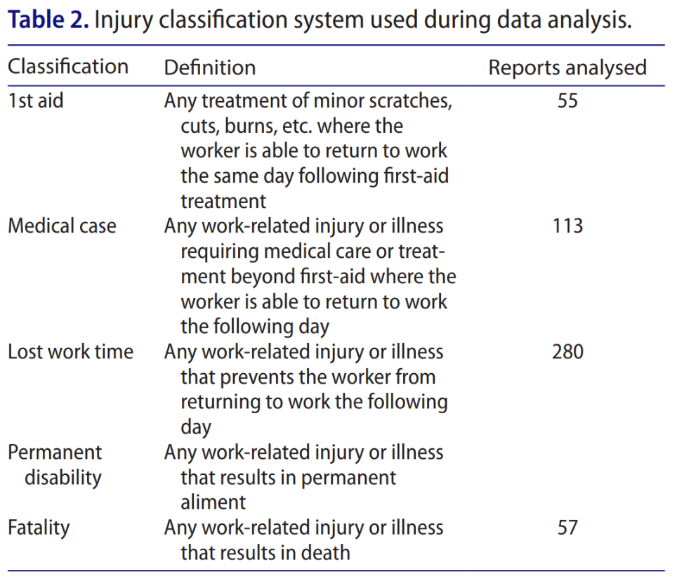
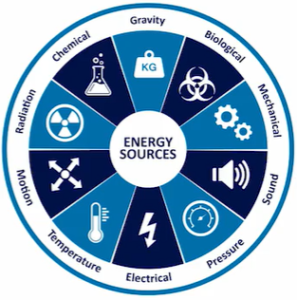
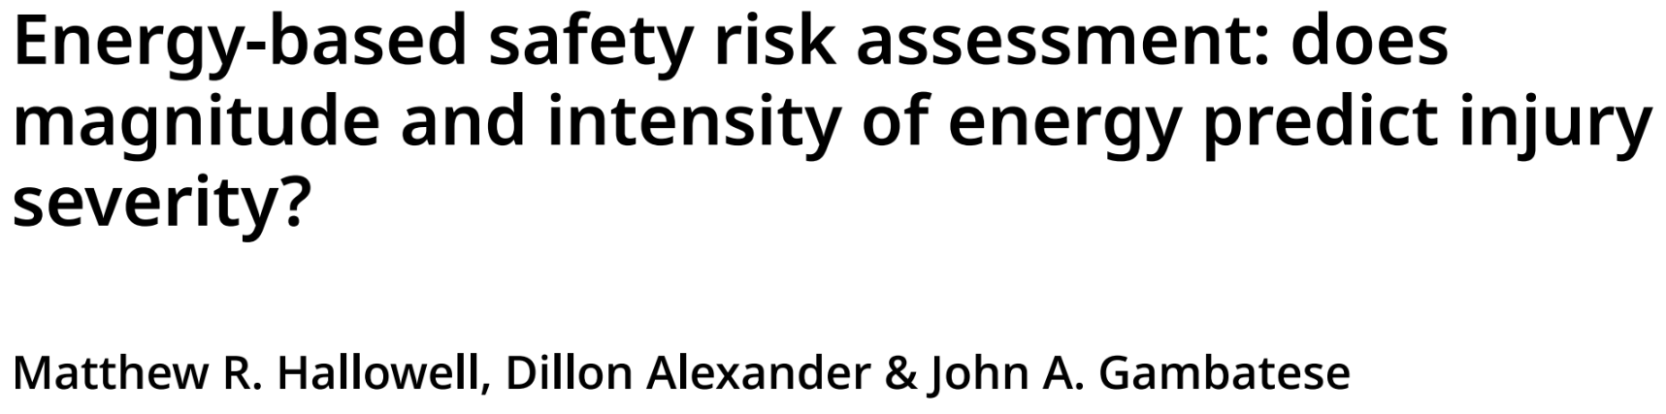
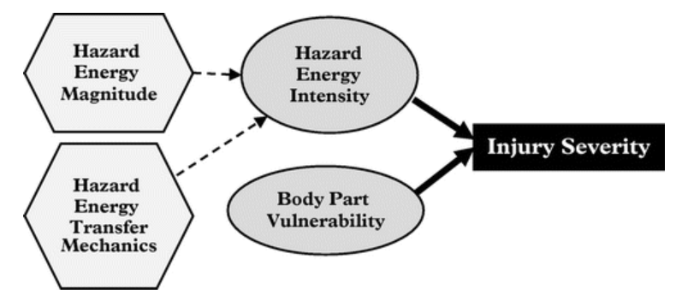
Sidebar | Energy and SIF
It is hard to “unsee” this once seen
Full article: Energy-based safety risk assessment: does magnitude and intensity of energy predict injury severity?
12

Slide 13
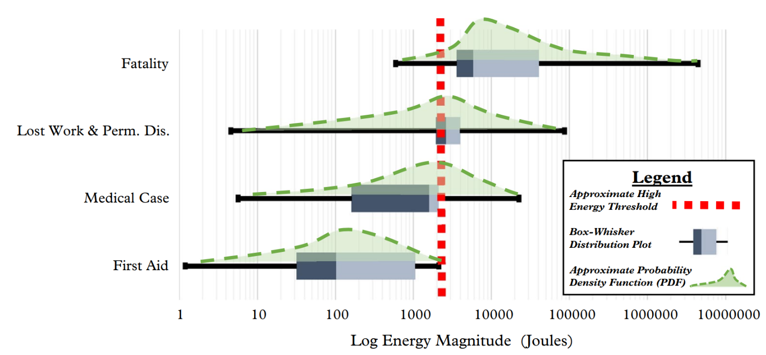
Sidebar | Energy and SIF
Full article: Energy-based safety risk assessment: does magnitude and intensity of energy predict injury severity?
13
Notes:
Thick dotted red line is 1,500 Joules and think red lien is ~700 Joules (based on EEI SCL 500-foot pounds that captures more of the fatality outcomes.

Slide 14
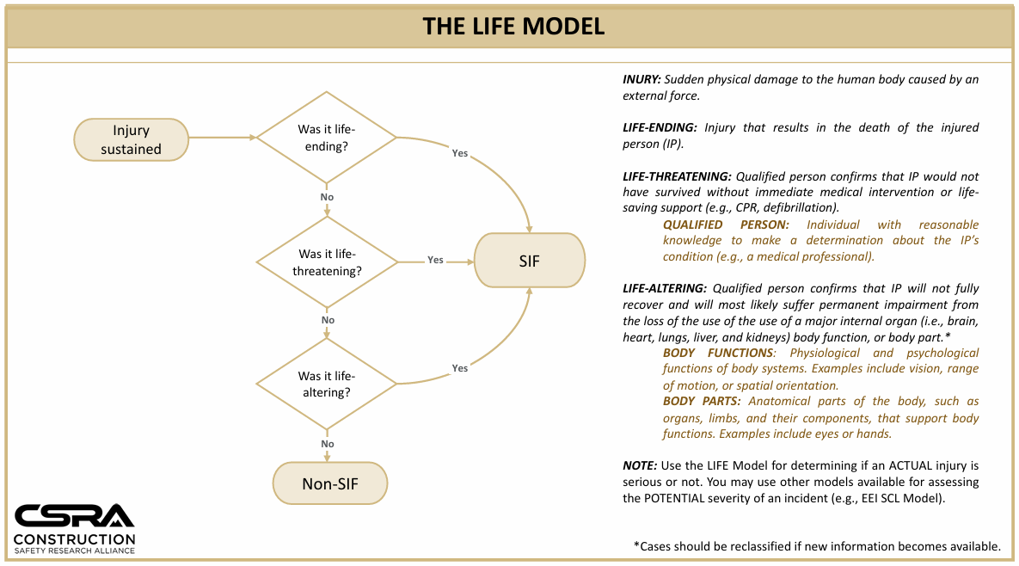


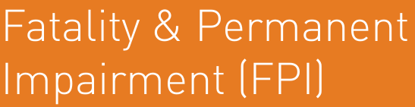
Existing Public SIF Definitions
What exists already that we can leverage?
What is meant by SIF?
Why is a public standard critical?
What does a good standard look like?
14

Slide 15
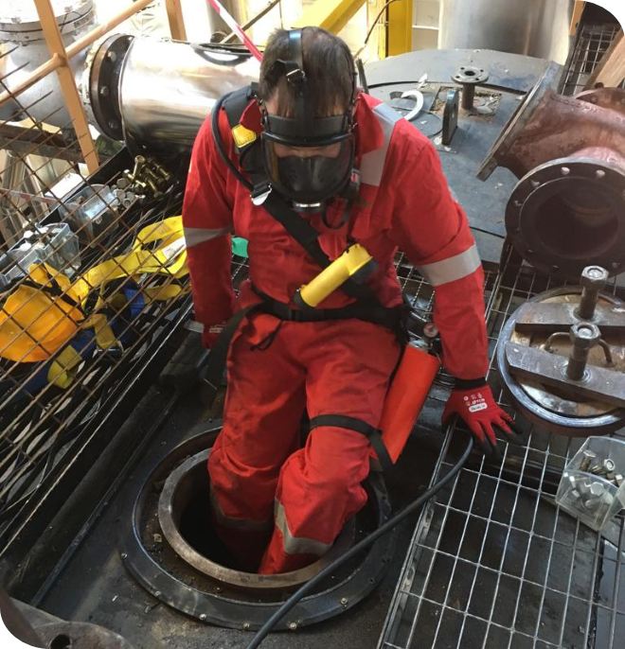
Do We Really Need to Define SIF?
The unfortunately, necessary, first step…
Everyone seems to believe this is an essential starting point
If TRIF is the problem…then SIF rate is the answer!
Fixation with incident classification with TRIF translates to fixation with classification with SIF
End goal should not be to replace TRIF lagging metric with SIF lagging metric
TRIF is statistically invalid and so will a SIF rate at a company level – only makes sense at an industry level
Everyone wants to start here, and you can’t fight it?
True for ESC in Canada…
likely true everywhere
The Path is Through NOT Around
Hint: You don’t have to, but you will!
15

Slide 16
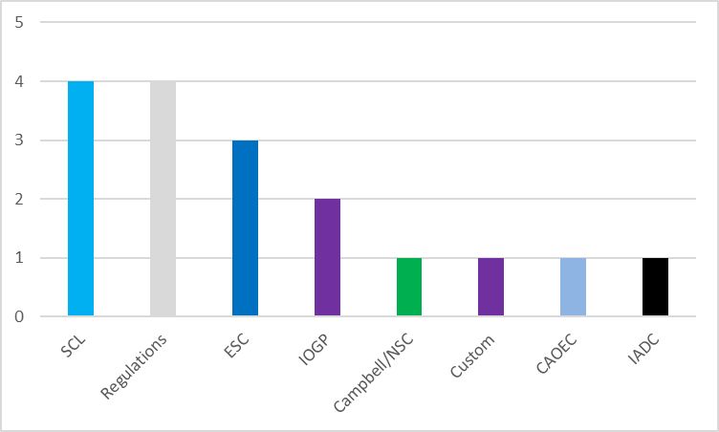
ESC SIF Survey | SIF-P
What we heard on SIF-Potential (SIF-P):
Three definitions included Edison, ESC and IOGP
Approximately 90% track SIF-P in some manner
25% track SIF-P rates and approximately 10% have
SIF-P on their scorecards
SIF-P criteria such as Edison Electric’s SCL model leads
to 2-5 times more data collection (Direct Controls)
100% felt that the SIF-A definition is the basis for the
SIF-P definition and this is where learning and sharing is easier.
Start with SIF Actual FIRST (Influences SIF-P Approach: IOGP, ASTM)
SIF-P Definitions in Use
16

Slide 17
Existing Public SIF Definitions
What exists already that we can leverage?
In the table below “High” is desirable over “Low” and values are comparative.
SIF Def | SIF Validity | Simplicity | Comparability | Counts | Approx Ratios*
Edison Electric | High | High | Medium | 2H 1M | 1:10
IOGP | High | Medium | High | 2H 1M | 1:1
Life Model** | High | High | Low | 2H 1L | --
ASTM (2026)*** | High | Medium | Medium*** | 1H 2M | --
Hurt Model | High | Medium | Low | 1H 1M 1L | --
TRIF | Low | High | High | 2H 1L | --
50+ Days | Medium | High | Medium | 1H 2M | 1:20
50+ D High E | Medium | High | Low | 1H 1M 1L | 1:10
* Fatality to Serious Injury or Permanent Impairment Ratio
** CAOEC Incident Statistics Program aligns with the Life Model
17
*** ASTM Standard access is significantly restricted and complex

Slide 18
SIF Definition Models
What is a serious injury and fatality (SIF)?
Approx Criteria #
SIF Models
Unique Aspects
CSRA Life
Life Threatening
+
Life Altering Injuries
+
Life Ending (Fatalities)
5
Life threatening
Edison Electric*
Life Threatening
+
Life Altering Injuries
+
Life Ending (Fatalities)
15
LOC>30 min
X
Life Altering Injuries
+
Life Ending (Fatalities)
Mental disorders, 180-day window, SIF-P as PI
IOGP FPI
24
Life Threatening
+
Life Altering Injuries
+
Life Ending (Fatalities)
ASTM (2026)
17
Mental disorders
18
*Edison aligns with Safety Classification and Learning SIF-P model that is energy based and predominant SIF-P model in the world.

Slide 19
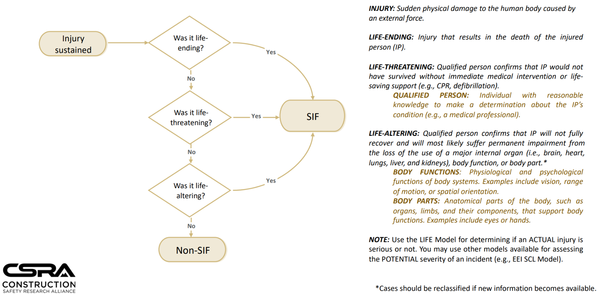
SIF Models | CSRA Life Model
19

Slide 20
SIF Model Comparison
Dimension | EEI SIF Criteria (Edison) | IOGP FPI
Purpose/Basis | Defines Serious Injury & Fatality with medically specific injury categories for consistent case coding. Threshold based. | Defines Fatality and Permanent Impairment (PI) Outcome based.
Function | Injury list‑ thresholds (e.g., Traumatic brain injury (TBI), organ trauma, burns, fractures, etc.) | Whole‑person function; PI includes body parts, organ function, musculoskeletal, psychological/cognitive/social.
Psychological injury | Not explicitly included as a qualifying category. ✅ | Included (e.g., PTSD preventing return to prior function - permanent). ⚠️
Amputations | Amputations involving bone; excludes distal phalanx unless thumb/index/big toe. ✅ | Permanent loss of body parts qualifies as PI ⚠️
Head/brain injuries | TBI/intracranial bleeding or >30 min Loss of Consciousness (LOC) | PI if lasting cognitive/neurological impact (e.g., epilepsy, cognitive dysfunction).
Organ injuries | Trauma to vital organs (brain, spinal cord, heart, lungs, kidneys, liver, spleen, intestines, stomach). | Permanent reduction of any organ function (heart, lungs, etc.) qualifies.
Burns | 2nd‑degree ≥10% Body Surface Area (BSA); 3rd‑degree ≥5% BSA or requiring graft ✅ | Deep burns with scarring/skin grafts that permanently impair function → PI.
Fractures | Only fractures requiring surgery (pins/plates etc.); excludes fingers/toes even if requires ORIF. | PI if ongoing impairment to mobility/function (outcome based)
Dislocations | Hip, elbow, knee only; excludes shoulder/wrist/ankle. | Not a discrete category; PI if lasting functional loss.
Timeframe | No analogous 180‑day MMI rule in criteria; classify per injury list. Majority of criteria are typically assessed in 24-72 hrs. | 180‑day Maximum Medical Improvement (MMI) rule to decide PI status; encourages follow‑up.
20

Slide 21









Serious Injury and Fatality Model
Edison Electric Institute
VS
Fatality & Permanent Impairment Model
International Association Of
Oil & Gas Producers’
Detects seriousness closer to the incident
“Was this serious when it happened?”
Confirms seriousness based on long-term outcome
“Did this become life-altering?”
 | THRESHOLD EFFECT Higher injury threshold Life-threatening / life-altering detected soon after incident (typically within 24–72 hours) |  |  | LAGGING OUTCOME EFFECT Lower injury threshold Outcome (permanent impairment) determined up to 180 days
 | DATA VOLUME Larger actuals dataset Better trend visibility and statistical power |  |  | DATA VOLUME Smaller actuals dataset More statistical noise
 | CRITERIA EFFICIENCY/THOROUGHNESS 15 criteria Efficient framework Focused on what drives early detection and action |  |  | CRITERIA EFFICIENCY/THOROUGHNESS 24 criteria More detailed and granular Focused on capturing all relevant permanent impairments
 | LEARNING IMPACT More events, faster feedback loop Enables quicker action to prevent recurrence |  |  | LEARNING IMPACT Fewer events and delayed confirmation Lessons emerge later but with higher medical certainty
within 24–72 H
Up to 180 Days
More Actuals
Fewer Actuals
15 Criteria
24 Criteria
Fast Loop
High Certainty
Focus on early detection to drive immediate action.
Focus on long-term outcomes with high medical certainty.

Slide 22
SIF Scenario | Group Activity
Insert Your own workplace Scenario/Story here
22
Notes:
Add your own story here.

Slide 23
SIF Scenario | Group Activity
Adjust based on Your own workplace Scenario/Story
Let's explore a few scenarios:
#1. A worker is rescued, but cognitive function is permanently impaired due to reduced oxygen to the brain:
  Is this a Potential SIF or an Actual SIF?
  Actual = EEI & IOGP
#2. A worker is rescued and has a fractured clavicle that is surgically repaired with pins; they fully recover:
  Is this a Potential SIF or an Actual SIF?
  Potential = IOGP, Actual = EEI
#3. A worker is unconscious underwater and is revived using an AED, with no injury:
  Is this a Potential SIF or an Actual SIF?
  Potential = IOGP, Actual = EEI
What was the actual outcome?
23

Slide 24
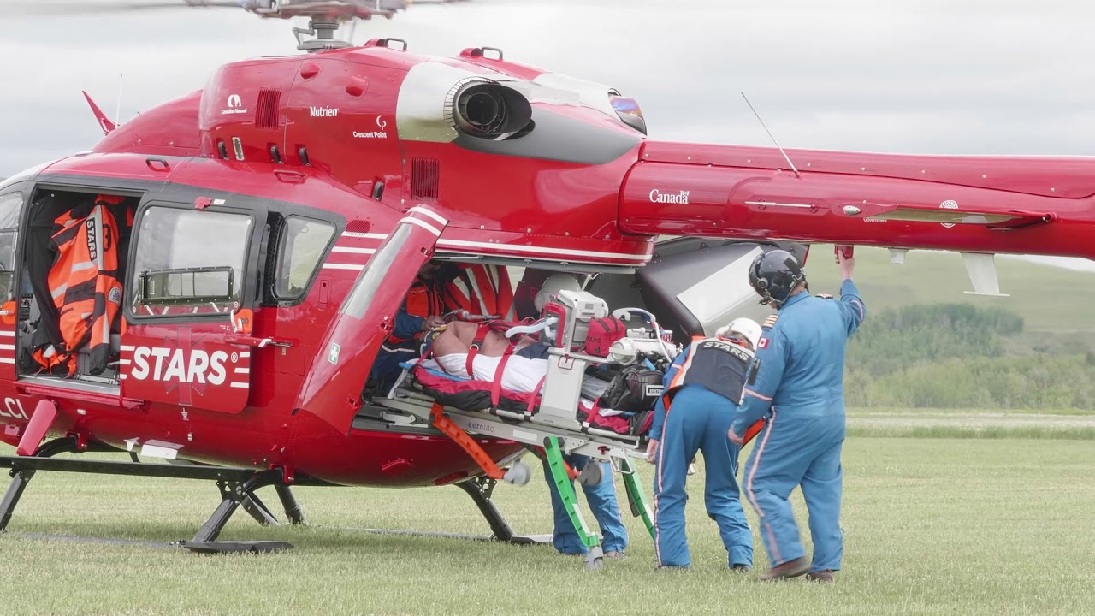
SIF Definition Model Example
Example: A sheave drops from the derrick and strikes a worker on the drill floor, fracturing their femur in several places.
How is this counted in each model?
  IOGP: Depends on the outcome. If not permanent impairment, NO. If the worker had permanently impaired function, then YES.
  Edison: Depends on the treatment severity. If the fracture requires pins, plates, etc. YES. If no pins, plates, then NO.
How are these tied to what happened at site versus what happened at the hospital versus during rehabilitation?
Is prevention about making the workplace safer, improving recoverability, or both?
24

Slide 25
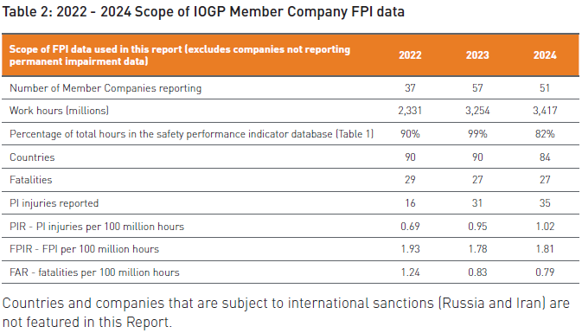

IOGP Definition - Data Implications
What can we learn about the size of the potential data?
SIF events are exceedingly rare.
At the individual company level, annual SIF counts are too small to support statistically meaningful trends or comparative analysis.
Company‑level annual SIF rates are statistically indistinguishable from noise.
For most companies, this will be zero until it is not.
Only as an industry working together can we understand and make meaningful improvement.
25

Slide 26
SIF Examples – Group Activity
Now
Is this SIF-A?
% Yes
Then
Is this SIF-A?
% Yes
Case Examples – What is SIF (EEI – Page 4)?
Example #1: An employee is admitted to hospital with a puncture wound to their abdomen. They receive exploratory surgery, are stitched up and kept for two days for observation. They fully recover with no impairment.
Example #2: An employee is knocked unconscious and is admitted to hospital. They are in a coma within the Intensive Care Unit for two weeks after which they awake and are released with no injuries or impairments.
Example #3: An employee tears their shoulder while lifting a valve. They return to full duties 5 months later.
Example #4: An employee is shocked in the workplace resulting in a cardiac arrest. Site personnel use an AED to restart the worker’s heart and they completely recover.
##
##
##
##
##
##
##
##
Being Consistent is Key
26
Notes:
Life-threatening - Qualified person confirms that Injured person would not have survived without immediate medical intervention or life-saving support (e.g., CPR, defibrillation). f1bayona_0923.pdf
Life-Altering - Qualified person confirms that IP will not fully recover and will most likely suffer permanent impairment from the loss of the use of a major internal organ (i.e., brain, heart,
lungs, liver, and kidneys), body function, or body part. They define body function as: Physiological and psychological functions of body systems. Examples include vision, range
of motion, or spatial orientation. They define body parts as: anatomical parts of the body, such as organs, limbs, and their components, that support body functions. Examples include eyes or hands.
IOGP’ defines permanent impairment as the outcome of a work-related injury from which the worker cannot or is not expected to return to their previous whole function as a result of a single incident, resulting in any of the following: permanent loss of body parts, permanent reduction of organ’s psychological function, permanent reduction in skin and musculoskeletal function and permanent reduction in psychological, social or cognitive function. IOGP Fatality and Permanent Impairment | IOGP

Slide 27
Existing Public SIF-P Definitions
SIF-P Models
SIF-P Def | Strengths/Weaknesses | Impacts | Opportunity
SCL | Classification Tree – Performance based, Energy-based including low-energy SIF Based on direct controls and Worst credible outcome (>50%) | A higher standard Likely increases SIF-P numbers by several times | Could ESC collect this larger SIF-P data? Focus on ‘Priority Learning Events’.
ASTM | Prescriptive based, long list of incidents deemed to be a SIF-P Controlled and uncontrolled nomenclature is of value | ASTM standard is not free and document is complex. | N/A
Campbell Institute | Uses a high-energy event list like Life Saving Rules Simple, no control criteria | Approach is dated | N/A
ESC | Classification tree, controls and flags repeats | Aligns with AB framework | Align with SCL
27
Notes:
Proof points
Summary note from July round table
2025 ops plan final stewardship
2025 at least 9 (6 AB through July WCB + OHS email Jan 23 – removed one duplicate in data sets, 0 Sask through Q3, 1 BC)
125 using 50+ hours for Alberta for serious injuries in 2025 (WCB data)
25 Sask using 50+ hrs through Q3
Safety Alerts and Notifications
9 since July (data source: 2025 Year End GOT Stewardship.) Full year total was 11.

Slide 28
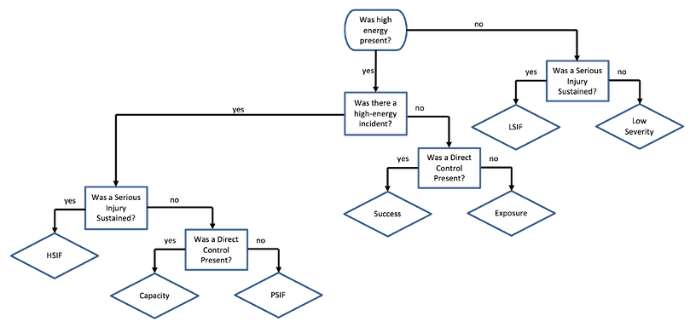
SCL Model
Safety Classification & Learning Model (EEI)
28
Notes:
Proof points
Summary note from July round table
2025 ops plan final stewardship
2025 at least 9 (6 AB through July WCB + OHS email Jan 23 – removed one duplicate in data sets, 0 Sask through Q3, 1 BC)
125 using 50+ hours for Alberta for serious injuries in 2025 (WCB data)
25 Sask using 50+ hrs through Q3
Safety Alerts and Notifications
9 since July (data source: 2025 Year End GOT Stewardship.) Full year total was 11.

Slide 29
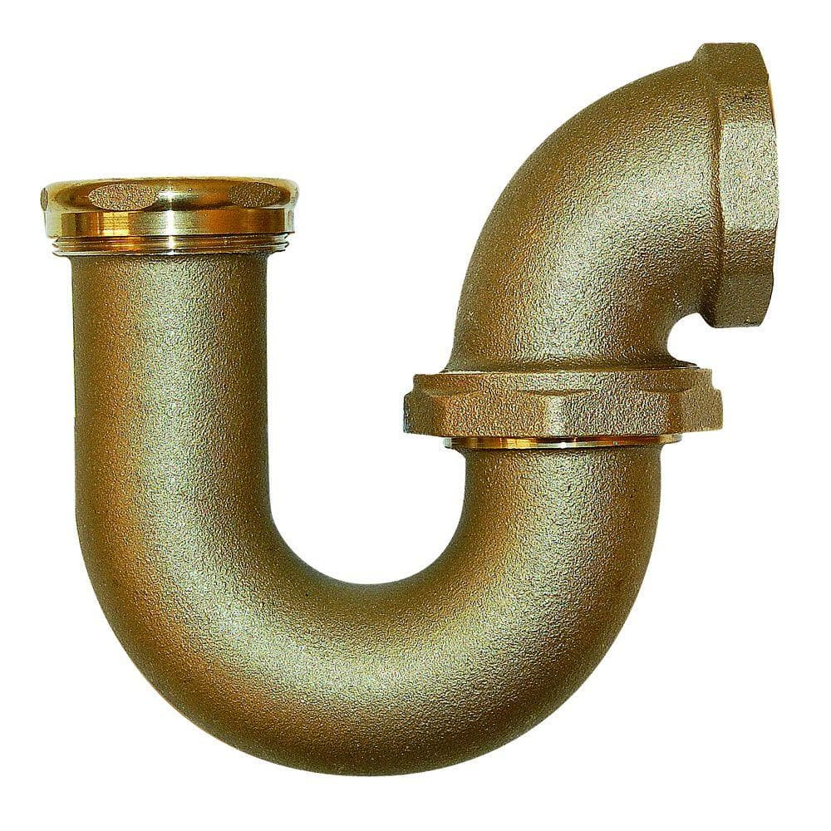
The P-Trap
The Use, Misuse and Value of SIF-P
Misuse!
  Putting SIF-P on a scorecard on the assumption that fewer of these is a sign of improvement
  More/less more likely a sign of safety culture
Use
  Collect these to learn lessons, identify poorly controlled fatality exposures
Value
  More is better, gifts from the front line to you, collect as many as possible
Is your system creating blockages to SIF-P reporting?
Too few SIF-A in the model will likely create pressure for SIF-P on the card!
29
Notes:
Proof points
Summary note from July round table
2025 ops plan final stewardship
2025 at least 9 (6 AB through July WCB + OHS email Jan 23 – removed one duplicate in data sets, 0 Sask through Q3, 1 BC)
125 using 50+ hours for Alberta for serious injuries in 2025 (WCB data)
25 Sask using 50+ hrs through Q3
Safety Alerts and Notifications
9 since July (data source: 2025 Year End GOT Stewardship.) Full year total was 11.

Slide 30
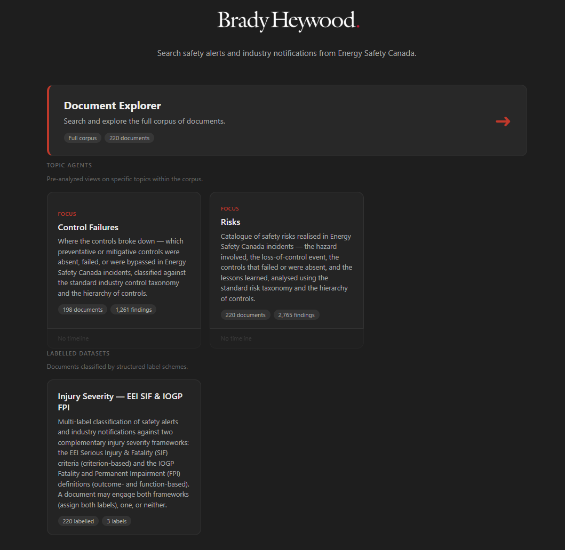
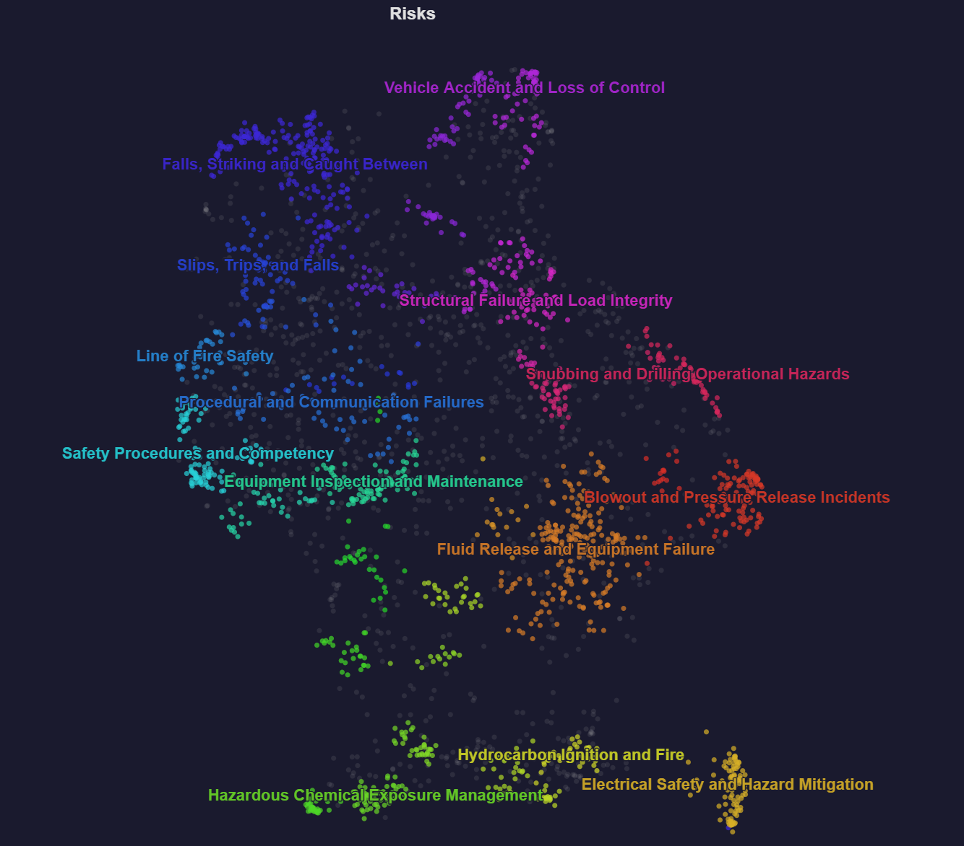
ESC SIF Prevention Insights Tool
Brady Heywood AI SIF Tool
ESC exploring tools to test and understand risk and critical controls
What do ESC Safety Alerts tell us?
30

Slide 31
ESC | What is Next?
ESC SIF Roadmap:
Align with EEI SCL SIF-P
Move to Leading Metrics
  (e.g., quality pre-job safety meetings, quality leadership engagements)
Focus on Direct Controls (HECA) / Critical Control Assurance
Accelerate Industry Sharing, Learning and Prevention (Direct Controls)
SIF Def
SIF Metrics
SIF Sharing, Learning & Prevention
31

Slide 32
Questions?

Slide 33
References
IOGP FPI Criteria
Edison Electric SIF Criteria
Edison Electric SIF Potential Criteria (SCL Model)
CSRA Life Model
CSRA The Tyranny of TRIR
Arnaldo Bayona. 2024. “The Things that Hurt People Are Not the Same as the Things That Kill People: Key differences in the Proximal Causes of Low- and High-Severity Construction Injuries”, ASCE, June 3, 2024.
33
Notes:
Here are a variety of resources to assist you in understanding this topic better.

Slide 34
SIF Models – IOGP FPI
Permanent impairment is defined as the outcome of a work-related injury from which the worker cannot or is not expected to return to their previous (pre-incident) whole person function as a result of an acute, single incident, resulting in any of the following:
Permanent loss of body parts
Permanent reduction or organ’s physiological function
Permanent reduction in skin and musculoskeletal function
Permanent reduction in psychologic, social or cognitive function
For reporting purposes, the classification is to be made within 180 days of the injury.
“Whole person function” relates to a person’s physiological/psychological status. Impairment is defined as either, or both:
Loss of ability to return to the previous work role
Loss of ability to perform the activities of daily living (ADL)
34

Slide 35
SIF Models – IOGP FPI
Permanent loss of body parts
  Amputations with loss of bone inclusive of one or more joints (not able to be reattached)
  Loss of eye(s)
  Loss of internal organs, e.g., kidney, spleen
  Loss of facial structures, e.g., nose, ears, leading to disfigurement
  Loss of genitalia or other sexual organs
  Successful use of prostheses does not negate a PI definition
Permanent reduction or organ’s physiological function
  Eye injury with permanent loss of vision
  Bowel injury requiring permanent stoma
  Spinal injury requiring ongoing use of wheelchair
  Brain injury causing ongoing epilepsy (recurrent seizures)
  Heart injury with impaired exertion tolerance/measurable permanent loss of function
  Lung injury, including inhalation, with impaired exertion tolerance/measurable permanent loss of function
  Injury causing loss of smell that creates an ongoing safety concern or significant personal impact
  Ear injury with permanent loss of hearing (at least equivalent to OSHA recordable shift), or persistent tinnitus (ear ringing) post injury after exposure to a blast
  Post injury complex pain disorders with ongoing uncontrolled pain and/or disrupted nerve and musculoskeletal function
  Genital or other sexual organ injury leading to permanent loss of function
35

Slide 36
SIF Models – IOGP FPI
Permanent reduction in skin and/or musculoskeletal function
Permanent reduction in skin and/or musculoskeletal function as a result of an acute/single incident due to mechanical trauma, thermal trauma, radioactivity, vibration, chemical exposure, or other, including but not limited to:
  Deep burns with scaring or skin grafts that permanently impair body movement or other function (more…)
  Tendon/ligament tear with ongoing abnormal joint range or movement for normal work or general function, e.g., cannot reach overhead, cannot squat, or cannot kneel.
  Traumatic soft tissue injury to shoulder/knee/elbow with ongoing abnormal joint range or movement
  Fracture with ongoing impairment to mobility
  Amputation with successful reattachment but permanent abnormal function
Permanent reduction in psychological, social or cognitive function
Permanent reduction in psychological, social or cognitive function as a result of an acute/single incident with psychological trauma, including an inability to self-care, and/or an inability to maintain previous work, social, and community relationships, post incident, including but not limited to:
  Brain injury with ongoing impact to emotional regulation, speech, memory, or other cognitive dysfunction
  Post incident psychiatric disorder/injury, including Post Traumatic Stress Disorder (PTSD), with inability to return to previous work role and/or schedule
36

Slide 37

SIF Models – Edison Model
An incident is classified as SIF if it meets one of the following criteria:
Fatalities
Amputations involving bone (excludes distal phalanx except thumb, index finger, or great toe)
Head trauma resulting in traumatic brain injury, intracranial bleeding, or loss of consciousness > 30 minutes
Injury or trauma to vital organs (brain, spinal cord, heart, lungs, kidneys, liver, spleen, intestines, stomach)
Bone fractures requiring surgery for repair (pins, rods, screw, plates, wires etc.) Excludes fingers and toes.
Acute traumatic herniated disc with neurological deficit - sensory or motor
Second degree burn (10% body surface); third-degree burn (5% body surface) or third-degree burn requiring skin graft.
Eye injuries resulting in permanent vision loss or change in vision
High pressure injection injuries requiring surgical debridement and irrigation.
Heat stroke
Dislocation of the hip, elbow or knee
Electrical contact injuries
Vascular trauma requiring surgery
Acute chemical or radiological exposure resulting in injury to vital organs to include brain, spinal cord, heart, lungs, kidneys, liver, spleen, large and small intestine and stomach
Other injuries (must meet life-threatening or life-altering definition).
37

Slide 38
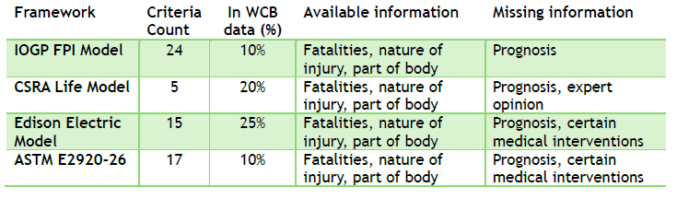
Task Group | SIF WCB Alignment
The various SIF models were assessed against WCB data that ESC has access to.
The WCB Percentages are based on the number of criteria recognizing that applied percentage coverage may be different.

Slide 39
SIF and Regulation Alignment
Jurisdiction / Model | Fatality | Life Threatening | Life Altering
CSRA Life | ✓ | ✓ | ✓
IOGP FPI | ✓ | X | ✓
Edison Electric | ✓ | ✓ | ✓
Alberta | ✓ | ✓ (Hospital Admission) | X
British Columbia | ✓ | ✓ (Critical Intervention) | ✓
Saskatchewan | ✓ | ✓ (72-hours Hospital Admission) | X
Federal Labour Code | ✓ | ✓ (Rescue/Revival) | ✓
Offshore CNSOER* | ✓ | ✓ (Endangers Life) | ✓
* Canada – Nova Scotia Offshore Energy Regulator
39
Notes:
WorkSafeBC: A serious injury is any injury that can reasonably be expected at the time of the incident to endanger life or cause permanent injury. Serious injuries include both traumatic injuries that are life threatening or that result in a loss of consciousness, and incidents such as chemical exposures, heat stress, and cold stress which are likely to result in a life threatening condition or cause permanent injury or significant physical impairment.
Traumatic injuries that should be considered "serious injuries" include
Major fractures or crush injuries, such as
A fracture of the skull, spine, or pelvis
Multiple, open or compound fractures, or fractures to major bones such as the humerus, fibula or tibia, or radius or ulna
Crushing injuries to the trunk, head or neck, or multiple crush injuries
An amputation, at the time of the accident, of an arm or leg or amputation of a major part of a hand or foot
Penetrating injuries to eye, head, neck, chest, abdomen, or groin
An accident that caused significant respiratory compromise, or punctured lung
Circulatory shock (i.e., internal hemorrhage) or injury to any internal organ
Lacerations that cause severe hemorrhages
All burns that meet the rapid transport criteria of the Occupational First Aid Training Manual, including
Third degree burns to more than 2% of the body surface
Third degree burns to the face, head, or neck
Burns of any degree with complications
An asphyxiation or poisoning resulting in a partial or total loss of physical control (i.e., loss of consciousness of a worker in a confined space) or a respiratory rate of fewer than 10 breaths per minute or severe dyspnea (difficult or laboured breathing)
Decompression illness, or lung over-pressurization during or after a dive or any incident of near drowning
Traumatic injury which is likely to result in a loss of
Sight
Hearing
Touch
Injuries that require a critical intervention such as CPR, artificial ventilation or control of hemorrhaging or treatment beyond First Aid, such as the intervention of Emergency Health Services personnel (e.g. transportation to further medical attention), a physician and subsequent surgery, or admittance to an intensive care unit should also be considered "serious injuries.“
SK: An incident that causes or may cause the death of a worker; or will require a worker to be admitted to a hospital as an in-patient for a period of 72 hours or more (OHS Regulations, Section 2-2).

Slide 40
SIF Models - Group Activity
Which classification better drives prevention, not just reporting?
What behaviours will each definition unintentionally encourage?
How much judgment is required to classify an event?
40

