Slide 1
SIF Journey Toolbox Talk
June 15, 2026

Slide 2
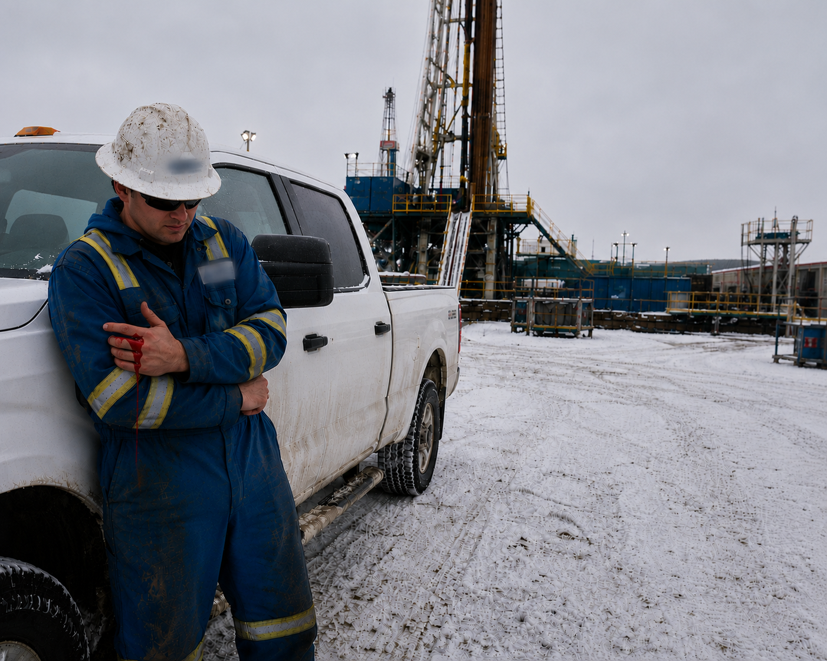
Story for Reflection | Group Activity
A rig manager crushes their finger in the pick-up truck’s door, and the fix was impact-resistant gloves for all workers that drive, enter or exit vehicles.
The company spends $75,000 on gloves (money originally budgeted for critical-risk management).
Is this a serious injury?
Is this good risk management?
How is the system driving this action?
2
Notes:
Provide the story and then have a discussion as a group in answering these questions?

Slide 3
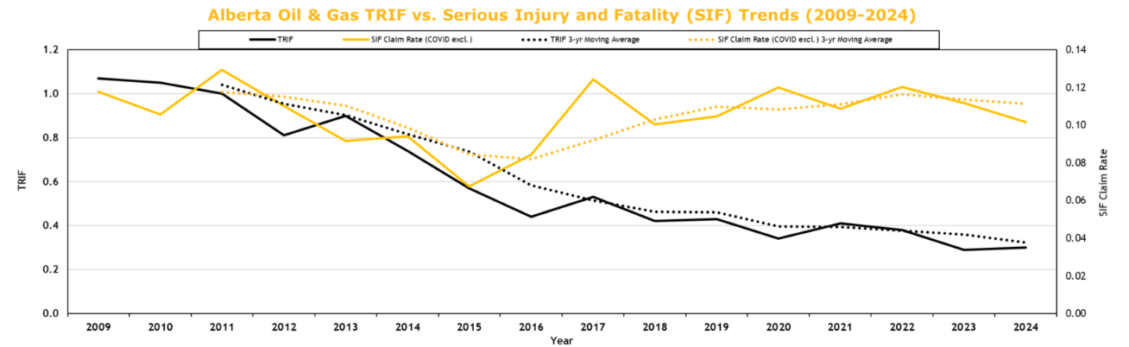
Context – The Case for Change
Despite our industry making great progress on reducing total recordable injury frequency (TRIF) over the past 15 years, we have not seen the same improvement in serious injuries and fatalities (SIF).
SIF
TRIF (- 70%)
SIF Claim Rate based on ESC’s Alberta WCB Oil and Gas Funding Codes based on 50+ days of Lost Time and Fatalities
Sources: Industry and WCB Alberta data.
Notes:
TRIF, a metric used to measure the presence of incidents, has been historically useful in helping guide industry safety improvement. However, TRIF is now no longer as useful with the safety performance that the energy industry has achieved. This coupled with the fact that this metric is not sensitive to severity as evidenced by the continued presence of more serious injuries and fatalities.

Slide 4
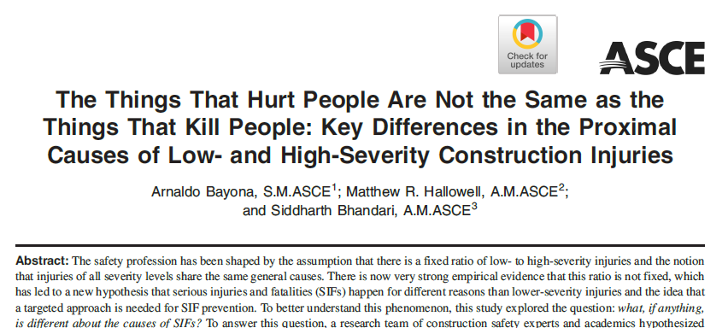
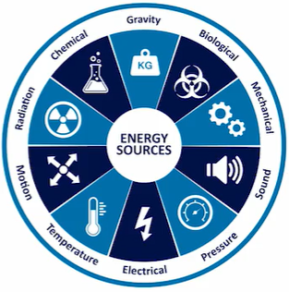
Moving to a SIF-Focused Industry
What seriously injures or kills is not the same as what causes minor injuries.
A metric that counts a finger cut the same as a fatality is not driving the focus where it need s to be.
Total Recordable Injury Rate or Frequency (TRIF) has proven useful in the past; however, with the evolution of safety performance, it no longer provides the insight needed.
The industry must prioritize preventing serious injuries and fatalities (SIF) by first defining what qualifies as a serious injury.
4
4
Notes:
Research has identified that the things that kill are not the same as the things that cause minor injury. One of these differences is around the presence of hazardous energy. TRIF counts all incidents as the same and that is a problem. Industry needs to prioritize serious injury and fatality prevention, and this begins with defining what we mean by a ‘serious injury’.

Slide 5
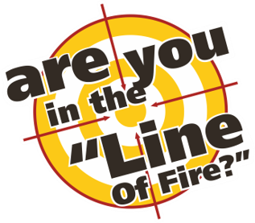
What is a Serious Injury?
Can existing data (2023-2025) help?
Top 3 Incidents by Type
SIF–P (PSI)* | OH&S SI Notification* | Serious Incidents (WCB 50+ days) | Fatalities
Struck/Contact with Objects | Struck/Contact with Objects | Bodily Reaction/Overexertion | Vehicle/Transportation
Vehicle/Transportation | Fire/Explosion | Falls - Same Level | Chemical/Substance Exposure
Chemical/Substance Exposure | Falls - Same Level | Struck/Contact with Objects | Struck/Contact with Objects
Struck/Contact with Objects (Line of Fire) is a pervasive risk across all data sets
Vehicle/Transportation and Chemical/Substance Exposure are less frequent but higher
fatal consequences (less recoverable)
Bodily Reaction/Overexertion and Falls - Same Level are common and major contributors
to lost time and cost but rarely lead to fatalities
The data reflects different realities and the need for a common definition of serious injury and industry data to improve the resolution of the picture.
Sources: WCB Alberta and Alberta OH&S data.
5
Notes:
Do we not already within Industry have an adequate definition of what is a serious injury? The answer is no. Industry currently uses a variety of proxies for serious, such as hospital admission but Industry has not defined what is serious. As such, data from various sources such as Potentially Serious Data, Serious Incident Notifications, WCB and Fatality data all provide a slightly different lens as evidenced by the variation in top three incidents types. This is exactly, why a common definition of serious injury is needed.

Slide 6


SIF Definition – ESC Activities
Purpose:
Establish a clear, consistent SIF definition to support improved incident classification and learning.
This is about re-prioritization—not doing more!
The first step in many to prevent SIF
ESC Activities to Date:
Convened a multi‑stakeholder SIF Task Group (49)
Held 8 meetings between March 11 and April 15
Reviewed existing incident classification frameworks and leading practices
Group alignment on two models: Edison Electric and IOGP
Both are different in approach and have strengths and weaknesses
6
Notes:
In early 2026, ESC undertook an initiative to focus industry on a standardized definition of SIF. A committee of more than 32 companies and 49 representatives was established from across industry to stack hands on publicly available SIF definition. The committee stacked hands on two criteria, the Edison Electric SIF Criteria and the Internation Association of Oil and Gas Producers Fatality and Permanent Impairment criteria. These two model are both valid and will be used within industry to help aid in the prevention of SIF.

Slide 7
SIF Definition – Practical Reality
What does this mean?
Both definitions are acceptable and will be encountered within industry.
Both focus on injuries and therefore are from single acute incidents (not illnesses).
IOGP defines SIF as Fatalities and Permanent Impairment
      IOGP includes impairment to physical, psychological or social function
Edison Electric Institute (EEI) defines SIF as Life ending, Life alerting and
Life threatening
    EEI limits SIF to more serious physical injuries, while capturing traumatic injuries
    associated with elevated hazardous energy (e.g., fractures)
7
Notes:
You will encounter both definitions within industry. These define what a serious injury is. As such, they are focused on single acute incidents that result in injury not illnesses that could result from chronic repeated exposures.
IOGP defines SIF as Fatalities and Permanent Impairment. FPI includes permanent impairment to physical, psychological or social function. It provides a measurement window of 180 days to capture the impacts of an injury.
Edison electric defines SIF as life ending, life altering and life threatening. EEI uses a more serious threshold that IOGP and captures traumatic injuries associated with elevated energy such as major bone fractures.

Slide 8


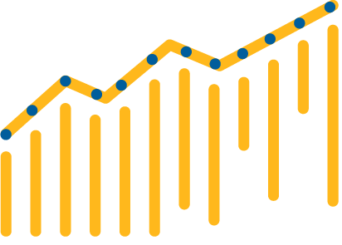
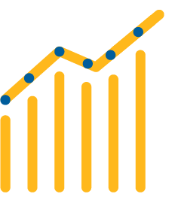





Serious Injury and Fatality Model
Edison Electric Institute
VS
Fatality & Permanent Impairment Model
International Association Of
Oil & Gas Producers’
Detects seriousness closer to the incident
“Was this serious when it happened?”
Confirms seriousness based on long-term outcome
“Did this become life-altering?”
 | THRESHOLD EFFECT Higher injury threshold Life-threatening / life-altering detected soon after incident (typically within 24–72 hours) |  |  | LAGGING OUTCOME EFFECT Lower injury threshold Outcome (permanent impairment) determined up to 180 days
 | DATA VOLUME Larger actuals dataset Better trend visibility and statistical power |  |  | DATA VOLUME Smaller actuals dataset More statistical noise
 | CRITERIA EFFICIENCY/THOROUGHNESS 15 criteria Efficient framework Focused on what drives early detection and action |  |  | CRITERIA EFFICIENCY/THOROUGHNESS 24 criteria More detailed and granular Focused on capturing all relevant permanent impairments
 | LEARNING IMPACT More events, faster feedback loop Enables quicker action to prevent recurrence |  |  | LEARNING IMPACT Fewer events and delayed confirmation Lessons emerge later but with higher medical certainty
within 24–72 H
Up to 180 Days
More Actuals
Fewer Actuals
15 Criteria
24 Criteria
Fast Loop
High Certainty
Focus on early detection to drive immediate action.
Focus on long-term outcomes with high medical certainty.
Notes:
This slide compares two different approaches to understanding serious injuries.
On the left is the EEI Serious Injury and Fatality model, and on the right is the IOGP Fatality and Permanent Impairment model.
At a high level, the key difference is timing — one focuses on early detection, the other on confirmed long-term outcomes.
🔵 Left Side – EEI SIF Model (Early Detection)
Starting with the EEI SIF model…
This approach asks: ‘Was this serious at the time it happened?’
It aims to detect seriousness within 24 to 72 hours of the incident.
It uses a higher injury threshold and identifies potentially life-altering events very soon after they occur. Because it captures more events early, you get a larger dataset, which improves trend visibility and statistical confidence.
It uses 15 criteria, making it relatively efficient and practical to apply.
The big advantage is a fast feedback loop—more events, quicker learning, and faster action.
So overall, this model is designed to drive immediate action through early detection.
🟠 Right Side – IOGP FPI Model (Outcome-Based)
Now looking at the IOGP Fatality and Permanent Impairment model…
This approach asks a different question: ‘Did this become life-altering?’
Instead of early detection, it confirms outcomes over time—up to 180 days.
It uses a lower initial threshold but waits to determine if the injury results in permanent impairment.”
Because of this, there are fewer actual cases, and more statistical variability.
It includes 24 criteria, making it more detailed and granular.”
You get higher medical certainty, but learning comes later due to fewer and delayed confirmed events.”
So this model prioritizes accuracy and certainty of long-term outcomes.”
In simple terms:
EEI SIF = early signal, more data, faster action
IOGP FPI = confirmed outcome, fewer cases, higher certainty
Neither approach is ‘better’—they serve different purposes depending on what you’re trying to achieve.
The key takeaway is that organizations often need to balance both—acting early on potential serious events while also tracking confirmed long-term impacts.

Slide 9
Reflective Questions
Discuss as a group:
What safety activities have you observed that were not supportive of SIF prevention?
What system were driving these actions?
How can we, as an industry, change the system to prioritize SIF prevention?
9
Notes:
Discuss:
What safety activities have your observed that were not supportive of SIF prevention?
What system was driving these actions?
How as an industry can we change the system to prioritize SIF prevention?

Slide 10
References
IOGP FPI Criteria
Edison Electric SIF Criteria
Edison Electric SIF Potential Criteria (SCL Model)
CSRA Life Model
CSRA The Tyranny of TRIR
Arnaldo Bayona. 2024. “The Things that Hurt People Are Not the Same as the Things That Kill People: Key differences in the Proximal Causes of Low- and High-Severity Construction Injuries”, ASCE, June 3, 2024.
10
Notes:
Here are a variety of resources to assist you in understanding this topic better.

