Slide 1
The National Safety Association For Canada’s Energy Industry
May 2026

Slide 2
Who is ESC | Energy Industry’s Safety Ally
Who is ESC
For over 75 years, Energy Safety Canada has been the national safety association for Canada’s energy industry. Created by industry, for industry, we are dedicated to keeping energy workers safe and driving safety performance.
Deliver industry-recognized training to meet industry needs.
Collaborate with industry to drive continuous safety improvements.
Provide safety and labour market data, insights and tools.
Serve as the industry certifying partner for the Certificate of Recognition program.
We are proud to work on behalf of Canada’s energy industry associations.
Notes:
Training Excellence - ATPs across Canada
Industry Impact – SSC, Advisory Committees, CoPs
ESC is recognized as Canada’s national safety association advancing SIF prevention, strengthening Canada’s role in global safety collaboration, & expanding training & knowledge opportunities across established & emerging markets.
Our strategic drivers continue to resonate across the industry. They remain the foundation of how we create value for workers, companies & the industry.
In 2026, ESC will further optimize training systems & collaboration with a focus on SIF prevention.

Slide 3
Who is ESC | Built by Industry for Industry
Energy Safety Canada Board of Directors
Safety Standards Council
Energy Safety Canada Advisory Committees
(Corporate, BC, SK)
Industry Committees
  Oil Sands Safety Committee
  Communities of Practice
    DROPS Canada, HOP, Workplace Exposures, Pipeline, Process Safety
  COR Program Committee
  Training Program Committees (E.g., H₂S Alive)
  Industry Associations & DACC
  CSA Standards Committees
  Provincial Committees
    E.g., AB OH&S, WCB
  Industry Project Groups as required
    E.g., Creative Sentencing, CSO
  International Committees
    E.g., Safe Work Together, Energy Institute, IOGP, CRSA
Energy Safety Canada

Slide 4
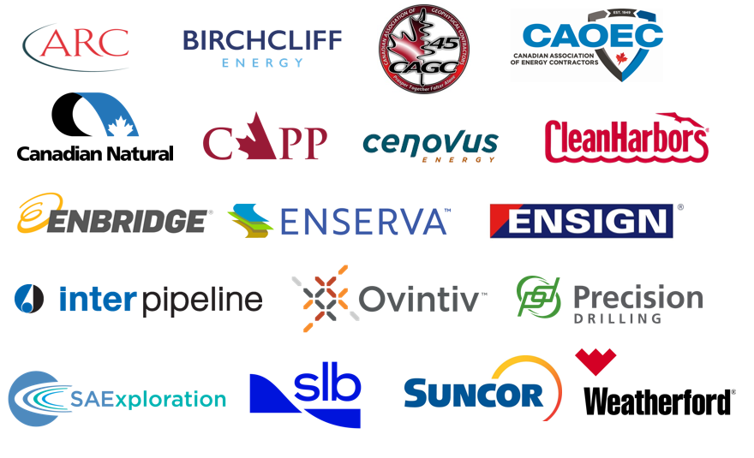
By Industry For Industry
Board of Directors
Safety Standards Council Members
Peter Zebedee | Board Chair & Executive Vice President, Oil Sands, Suncor
Mary Cianchetti | President, Standards, CSA Group
Colin Dease | President & CEO, AKITA Drilling
Mike Doyle | President, CAGC
Céline Gerson | President & Group Director, Americas, Fugro
Cheryl Gomez-Smith | Sr. Vice President, Upstream, Imperial Oil
Dean Halewich | SVP, Safety, Risk Management & Innovation, Canadian Natural
Tejay Haugen | Vice President, Operations Planning, ARC Resources (EPAC)
Kevin Krausert | CEO & Co-Founder, Avatar Innovations
Gurpreet Lail | President & CEO, Enserva
Russell Nibogie | Vice President, Operations, CAOEC
Laura Sayavedra | Senior Vice President, Safety & Reliability, Projects & Chief Administrative Officer, Enbridge
Luke Schauerte | CEO, Woodfibre LNG
Richard Wong | Vice President, Regulatory & Operations, CAPP
Drives the creation and adoption of standards and best practices
to facilitate safe operations and the reduction of injury and illness in the Canadian energy industry.
Shelley Powell, SVP, Suncor Energy – Past Chair; Chair appointment under review
Corey Lazar, VP, Precision Drilling – Vice Chair

Slide 5


By Industry For Industry
Purpose:
Establish a clear, consistent SIF definition to support improved incident classification and learning.
This is about re-prioritization—not doing more!
The first step in many to prevent SIF
ESC Activities to Date:
Convened a multi‑stakeholder SIF Task Group (49)
Held 8 meetings between March 11 and April 15
Reviewed existing incident classification frameworks and leading practices
Group alignment on two models: Edison Electric and IOGP
Both are different in approach and have strengths and weaknesses
5
Notes:
In early 2026, ESC undertook an initiative to focus industry on a standardized definition of SIF. A committee of more than 32 companies and 49 representatives was established from across industry to stack hands on publicly available SIF definition. The committee stacked hands on two criteria, the Edison Electric SIF Criteria and the Internation Association of Oil and Gas Producers Fatality and Permanent Impairment criteria. These two model are both valid and will be used within industry to help aid in the prevention of SIF.

Slide 6


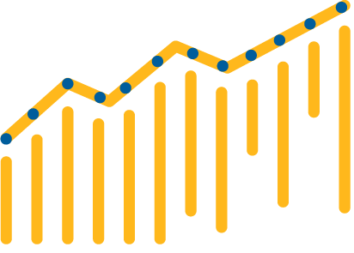
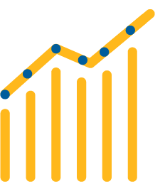





Serious Injury and Fatality Model
Edison Electric Institute
VS
Fatality & Permanent Impairment Model
International Association Of
Oil & Gas Producers’
Detects seriousness closer to the incident
“Was this serious when it happened?”
Confirms seriousness based on long-term outcome
“Did this become life-altering?”
 | THRESHOLD EFFECT Higher injury threshold Life-threatening / life-altering detected soon after incident (typically within 24–72 hours) |  |  | LAGGING OUTCOME EFFECT Lower injury threshold Outcome (permanent impairment) determined up to 180 days
 | DATA VOLUME Larger actuals dataset Better trend visibility and statistical power |  |  | DATA VOLUME Smaller actuals dataset More statistical noise
 | CRITERIA EFFICIENCY/THOROUGHNESS 15 criteria Efficient framework Focused on what drives early detection and action |  |  | CRITERIA EFFICIENCY/THOROUGHNESS 24 criteria More detailed and granular Focused on capturing all relevant permanent impairments
 | LEARNING IMPACT More events, faster feedback loop Enables quicker action to prevent recurrence |  |  | LEARNING IMPACT Fewer events and delayed confirmation Lessons emerge later but with higher medical certainty
within 24–72 H
Up to 180 Days
More Actuals
Fewer Actuals
15 Criteria
24 Criteria
Fast Loop
High Certainty
Focus on early detection to drive immediate action.
Focus on long-term outcomes with high medical certainty.
Notes:
This slide compares two different approaches to understanding serious injuries.
On the left is the EEI Serious Injury and Fatality model, and on the right is the IOGP Fatality and Permanent Impairment model.
At a high level, the key difference is timing — one focuses on early detection, the other on confirmed long-term outcomes.
🔵 Left Side – EEI SIF Model (Early Detection)
Starting with the EEI SIF model…
This approach asks: ‘Was this serious at the time it happened?’
It aims to detect seriousness within 24 to 72 hours of the incident.
It uses a higher injury threshold and identifies potentially life-altering events very soon after they occur. Because it captures more events early, you get a larger dataset, which improves trend visibility and statistical confidence.
It uses 15 criteria, making it relatively efficient and practical to apply.
The big advantage is a fast feedback loop—more events, quicker learning, and faster action.
So overall, this model is designed to drive immediate action through early detection.
🟠 Right Side – IOGP FPI Model (Outcome-Based)
Now looking at the IOGP Fatality and Permanent Impairment model…
This approach asks a different question: ‘Did this become life-altering?’
Instead of early detection, it confirms outcomes over time—up to 180 days.
It uses a lower initial threshold but waits to determine if the injury results in permanent impairment.”
Because of this, there are fewer actual cases, and more statistical variability.
It includes 24 criteria, making it more detailed and granular.”
You get higher medical certainty, but learning comes later due to fewer and delayed confirmed events.”
So this model prioritizes accuracy and certainty of long-term outcomes.”
In simple terms:
EEI SIF = early signal, more data, faster action
IOGP FPI = confirmed outcome, fewer cases, higher certainty
Neither approach is ‘better’—they serve different purposes depending on what you’re trying to achieve.
The key takeaway is that organizations often need to balance both—acting early on potential serious events while also tracking confirmed long-term impacts.

Slide 7



Industry-Wide Priority | 2026 ESC Focus
Industry anchored by a common goal:
SIF prevention focused on the worker
Progress requires:
Increased sharing across industry
Learning from SIFs (SIF-A and SIF-P)
Common language to drive analytics
Moving beyond TRIF metrics

Slide 8
SIF Task Group | Roadmap (May 2026)
Purpose: Building a cross-border platform to increase sharing of learnings across industry
Timeline:
Q1 2026
Q4 2026-Q1 2027
Q3 2026
Q2 2026
Evaluate
Expanded Industry Engagement
Stage:
Pilot Engagement
Operationalize
Key Activities:
Established industry SIF Task Group (30+ companies) to evaluate SIF actual definitions
Developed an AI-enabled dashboard to learn from SIF events across industry & move beyond TRIF
Partnering with 4-5 companies to contribute data.
Field testing AI tool outputs in operating environments.
Evaluate Data Gateway process.
Validate actionable insights, tools and resources.
Industry engagement through targeted events.
Scale validated insights, tools and resources
Enable consistent SIF Approach (IOGP, EEI)
Deliver practical prevention guidance
Share cross-industry learnings
Provide updates to ESC Board and Safety Standards Council.
Current Status:
Aligned on two definitions to evaluate further (EEI and IOGP FPI)
Testing the two definitions using AI

