Slide 1
Energy Wheel & Hazard Recognition Toolbox Talk

Slide 2
Hazard assessment
A hazard is a situation, condition or thing that may be dangerous to health and safety
Hazard recognition is a fundamental skill required for nearly all activities
We instinctively recognize hazards in our environment

Slide 3
Hazardous energy
Research has identified some forms of hazardous energy are easier to identify than others
Gravity and motion are the easiest to identify because they require limited cognitive (brain) processing
Mechanical, pressure and chemical are often not identified as they require greater cognitive processing (oxygen, time and location in brain)

Slide 4
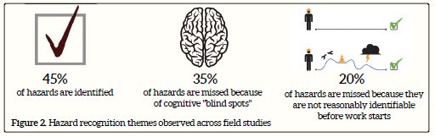
Incident causes
One of the most common causes for incidents is “hazard not identified”
Reference: Matthew Hallowell

Slide 5
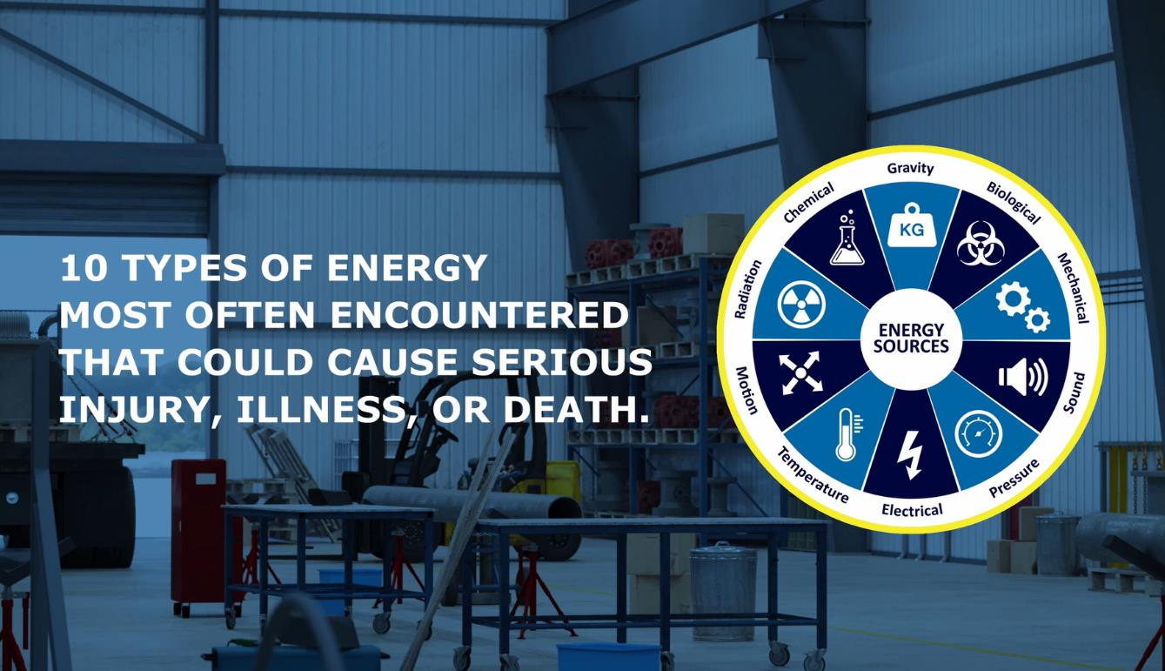
Energy wheel video

Slide 6
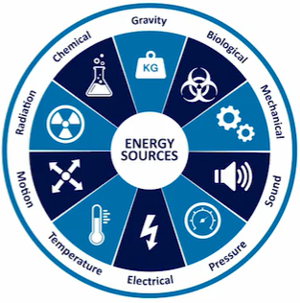
Energy wheel
Energy source descriptions:
Force caused by the attraction of mass to the earth
Living organisms or viruses
Working parts of a machine or assembly, including rotation, vibration, tension, or compression
Audible vibration caused by the contact of two or more objects
Liquid or gas compressed or under vacuum
Presence of electrical charge or current
Intensity of heat or cold in an object or substance
Change in the physical position or location of objects or substances
Objects or substances that emit electromagnetic waves or subatomic particles
Flammable or toxic objects or substances that pose health risks

Slide 7
Energy wheel benefits
Improves hazard recognition by an average of 30%, scientifically valid and impactful in practice
Use it to support any hazard assessment process beyond what can be identified by instinct
Use as a tool to help augment existing processes before considering changes to forms, etc.

Slide 8
Can you identify three new hazards using the energy wheel?
#1
#2
#3

Slide 9
Questions

Slide 10
References
Energy Wheel Video
Energy Wheel Product Store
Energy-Based Hazard Recognition (Matthew Hallowell)
Line of Fire - Vehicles and Mobile Equipment Video
Building Capacity to Manage Pressure
Potentially Serious Incidents
Life Saving Rules
Notes:
Gordon

