Slide 1



IMPROVING WORKPLACE SAFETY AND REDUCING OPERATIONAL RISKS
Using Risk Registers To Drive Accountability
May 2, 2024
Larry Pearlman, Founder
lpearlman@SAFETYand.org
www.safetyand.net
+1 984.920.7550
© 2023 SAFETYand Consulting Associates, Inc.

Slide 2
Larry Pearlman
Expertise in safety, risk, organization culture, and change management.
Select clients include BP, Chick-Fil-A, Delta Air Lines, Direct Energy, Exxon, FedEx, Hess, Hitachi, HSBC, Milliken, National Grid, Northrop Grumman, Pfizer, Shell, Suncor and Toyota.
In addition to SafetyAnd, Larry has been employed by Amoco, BP, General Mills, Marsh McLennan, PepsiCo and Pfizer. He is a certified lean Master Black Belt.
B.B.A. in Economics and Industrial Relations and Human Resources from the University of Iowa
M.A. in Labor and Industrial Relations from the University of Illinois in Urbana-Champaign.
He serves as an adjunct professor at the University of Illinois since 2012 and Columbia Southern University since 2024.

Slide 3

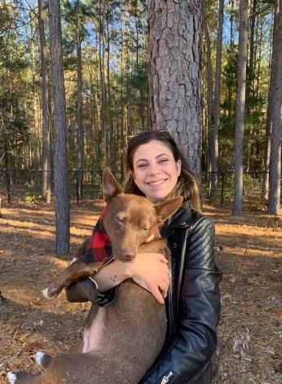



What’s Really Important to Me

Slide 4
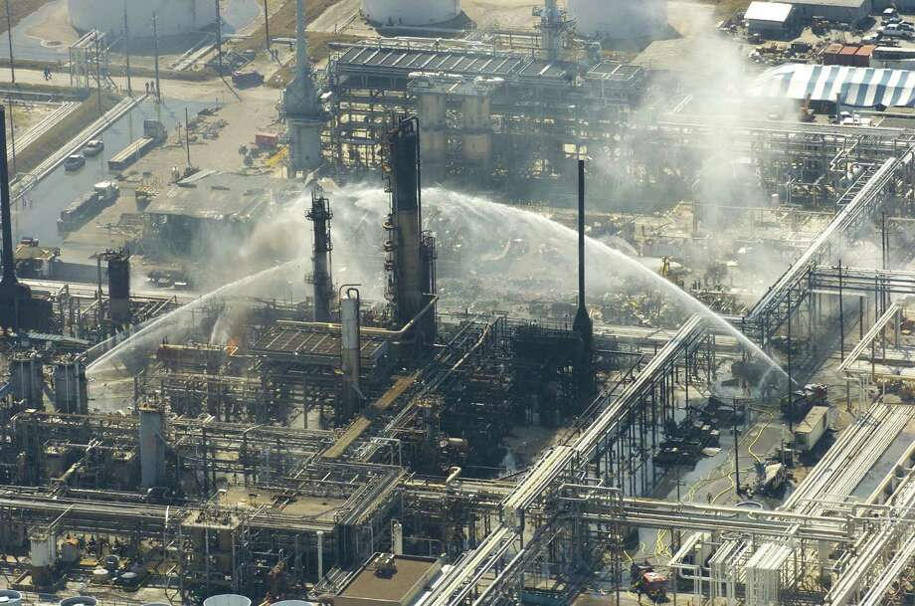
Bolton
Cruz
Herrera
Hogan
Hunnings
King
Linsenbardt
Ramos
Rodrigues
Rowe, J.
Rowe, L
Smith
Taylor
Thomas
White
March 23, 2005

Slide 5
Introductory Exercise
    What is risk?
      How well does your organization identify risk?
      Once you identify risk, how well does your company manage it?
      When it comes to risk, what would you like to learn?
1
2
3
4

Slide 6
Common risk identification issues
We fail to see risks that have not materialized previously.
We underestimate frequency and/or severity.
We believe that our risk controls are adequate.
We fail to review our actual frequency and severity against our predictions.
Risk is identified but ownership is unclear.
We lack proper risk metrics.
Leaders and Board members fail to put risk on the agenda.
We don’t allocate resources based upon risk
We fail to review risk systemically.
How we’ve always done things influences our risk tolerance.

Slide 7
Agenda
What accountability means
Governance.
Why we get risk so wrong.
Tools to assess risk.
Risk ownership.
Risk metrics.
OpEx & CapEx.
Management review.
Summary.

Slide 8

Governance discussion
Who owns operational risk in your organization?
What does operational risk governance look like?
How does ownership of risk link to your Safety Management System?
Is the risk and insurance function part of the governance process?
17 April 2024

Slide 9
Governance
What does good risk governance look like?
Clear governance structure.
Risk identification process.
Risk assessment process.
Monitoring approach
Reporting & metrics
Communication & training
Continuous risk reduction.

Slide 10
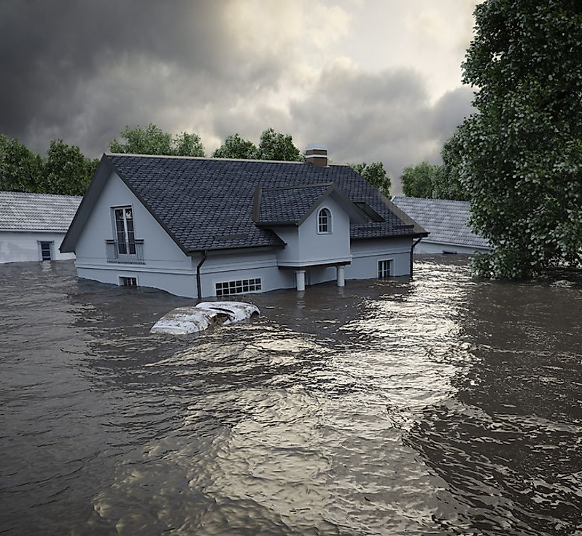
We often get risk assessment very wrong
Why do 100-year floods happen every seven years?

Slide 11

We often are more optimistic than we should be
93% of US drivers claim to be “above average!”
17 April 2024

Slide 12
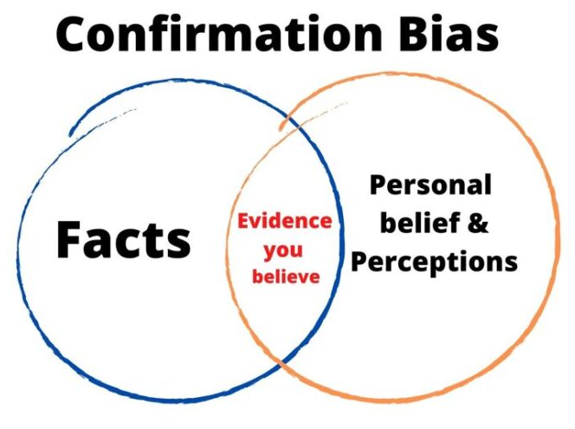
Our brains are lazy, and they cheat!
  We jump to limited data that confirms our existing perspective
  We ignore or fail to seek evidence that runs counter to the story in our mind (Deepwater Horizon and pressure readings)
17 April 2024

Slide 13
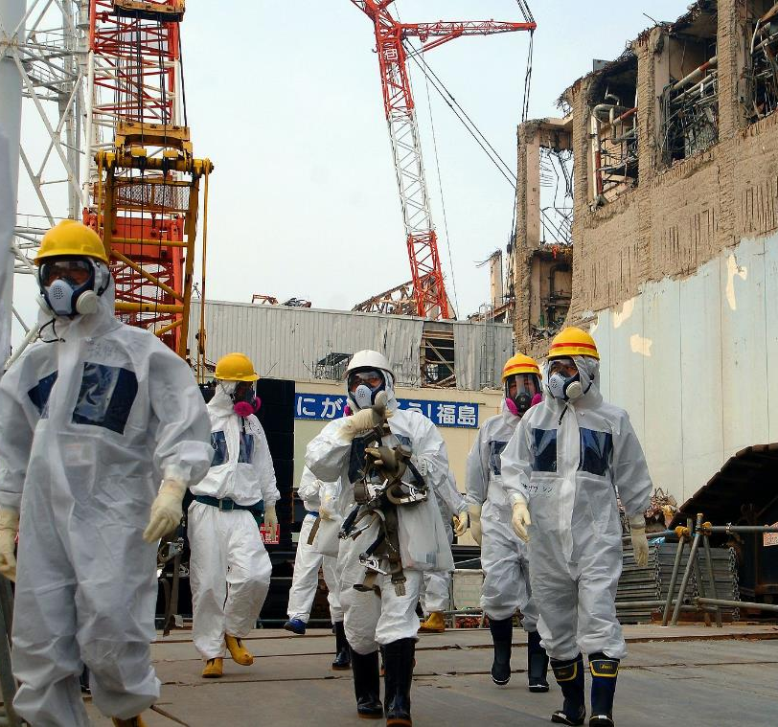
Our brains cheating causes errors in analysis and judgement…
  We become overconfident in our predictions, judgments, and intuitions…without data
  We create plans that are “unrealistically close to best-case scenarios.”
  We make decisions “based on delusional optimism” rather than on a “rational weighting of gains, losses, and probabilities.”
  We “take on risky projects because they are overly optimistic about the odds.” (Fukushima nuclear disaster)
17 April 2024

Slide 14




We underestimate risk
“It is not so much that we are incompetent at estimation and probability, but that we are confident in our incompetence”
- Paul Gibbons, PhD
Put in a range where you are 90% confident of being correct… (while maintaining an interest in precision)
Neurons in human brain_____ ____
Number of books in old testament _____ ____
Length of the Nile river _____ _____
Distance earth to the moon ____ _____
86 million
39
4130 miles
238,855 miles
17 April 2024
Notes:
86 million neurons in the human brain
39 books in OT
4130 miles
238,855 miles moon

Slide 15

Operational risk is pervasive
  How well risks are identified, quantified and mitigated can make the difference of a life lost (or saved).
  It can also be the difference between profit and loss.
17 April 2024

Slide 16

Defining risk management
The identification, assessment and prioritization of risks, followed by coordinated and economical application of resources to minimize, monitor and control the probability or impact of unfortunate events.
Risk management’s objective is to assure uncertainty does not deflect the endeavor from achieving its business goals.
Helping the organization see what’s around the corner and helping to navigate the path forward.
17 April 2024

Slide 17
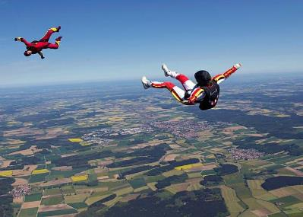

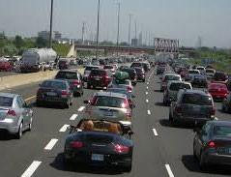





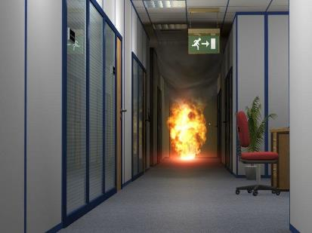

Risk assessment process
What’s wrong with this approach to risk quantification?
Skydiving fatal accidents – 25
Aircraft fatalities – 5
Vehicle fatal accidents - 40,000
Ladder falls – 100 workplace fatalities
Lightning strikes – 20
Workplace fires – 100 workplace fatalities
17 April 2024
Notes:
Ladder falls – 100 workplace fatalities
Workplace fires – 100 workplace fatalities
Lightning strikes – 20
Skydiving fatal accidents – 25
Vehicle fatal accidents - 40,000
Aircraft fatalities – 5

Slide 18
Risk assessment process - likelihood
Evaluate how likely the risk is to materialize
Very Likely: Has happened to us more than one time in the last year
Likely: Has happened in the industry more than one time in the last year
Possible: Has happened in our industry less than one time per year over the past five years
Unlikely: Has happened in our industry
Highly Unlikely: Never heard of in our industry
Your knowledge of the industry will help you classify frequency.
Seek a wide perspective because our brains are lazy, and they cheat!
17 April 2024

Slide 19

Risk assessment process - severity
Similar to likelihood, it helps to ground severity onto a scale
Minimal: Noticeable impact that can easily be recovered from with little damage to people, environment, assets or reputation (PEARs) – think first aid
Significant: Noticeable impact that can be recovered from. It impacts people, environment, assets or reputation for a short period of time and will take significant effort to recover from – think TRIR
Severe: Impacts that will damage the company’s ability to do business but will not cause a shutdown of operations or a loss of a ‘license to operate’ – think fatalities
Catastrophic: These may be company killing events - think multiple fatalities
17 April 2024

Slide 20
What could possibly go wrong?
Brainstorm a list of what could happen to your firm.
Categorize them as internal risks and external risks.
  Internal risks are within your control to mitigate or eliminate.
  External risks are beyond your control but can be planned for.
Typical risk types:
Compliance Risk Financial Risk Reputation Risk
Competitive Risk Safety Risk
Security, Cyber & Fraud
Environmental Risk
Economic Risk People Risk Supplier Risk
17 April 2024

Slide 21
Exercise: risk identification
 | INTERNAL RISKS | EXTERNAL RISKS
Compliance Risk
Competitive Risk
Economic Risk
Financial Risk
Operational Risk
People Risk
Reputation Risk
Security, Cyber, and Fraud Risk
Supplier Risk
Environmental Risk
17 April 2024

Slide 22
Utilize your brainstormed “risk list” and focus on 2 risks in your business
Evaluate “severity” as:
  Severe: Impacts that will damage the company’s ability to do business but will not cause a shutdown of operations or a loss of a ‘license to operate’ – think fatalities
  Catastrophic: These may be company killing events - think multiple fatalities
2. Evaluate “likelihood” as:
  Very Likely: Has happened to us more than one time in the last year
  Likely: Has happened in the industry more than one time in the last year
17 April 2024

Slide 23

Utilize your brainstormed “risk list” and focus on 3 risks in your business
Plot your risks on this matrix
 | A | B | C | D | E
Severity People Environment Assets Reputation | Highly Unlikely Never heard of in industry | Unlikely Heard of in industry | Possible Occurred <1 X per year in the industry | Likely Occurred < X per year in the industry | Very Likely Occurred within company
Slight (First Aid)
Minor (Recordable)
Significant (Lost Time)
Severe (Single Fatality)
Catastrophic (Multiple Fatality) | Note: Frequency scale are no | and severity n-linear.
How do you move stuff out of the red and orange?
17 April 2024

Slide 24
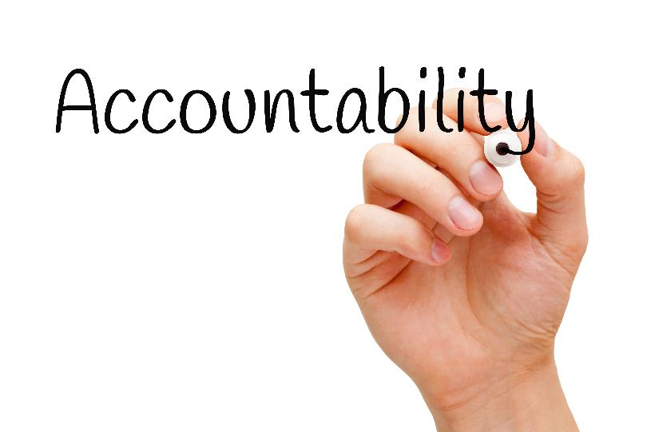
Building accountability
What are some of the better ways to drive accountability in your organization?
17 April 2024

Slide 25

How do you determine what is ‘safe enough?’
17 April 2024

Slide 26
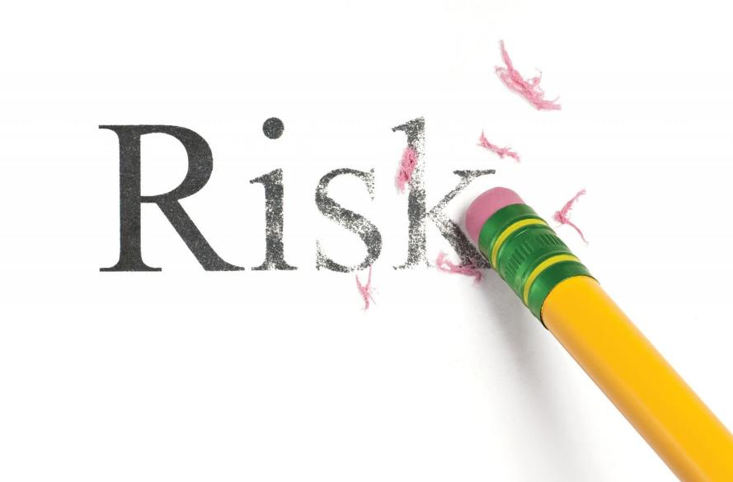
Risk registers
A comprehensive list that helps an organization manage risk effectively
A planning tool
Ap process to define risk acceptance
A process to establish ownership and accountability
A way to direct resources
May be created at any level in the organization with results being consolidated at a division or enterprise level
The register is a “living” document, being updated to reflect changes in operations, environment, actual experience and changes in risk ratings
Define who owns risk and what is ‘safe enough’ to accept’
17 April 2024

Slide 27
Sample risk register
PRIORITY | DESCRIPTION | OWNER | RISK RATING | MITIGATION APPROACH
HIGH | Fall from heights | VP Ops | RED | Tie Off Systems; Fall Protection
HIGH | Fall from ladder | VP Ops | RED | Ladder Requirements; Training
HIGH | Vehicle accident | VP Ops | RED | Telematics
MED | Loss of key personnel | VP HR | YELLOW | Incentives; Replacement Plan
MED | Cyber Attack | VP IT | YELLOW | Cyber Defenses; Back Up Systems; Cyber Insurance
17 April 2024

Slide 28
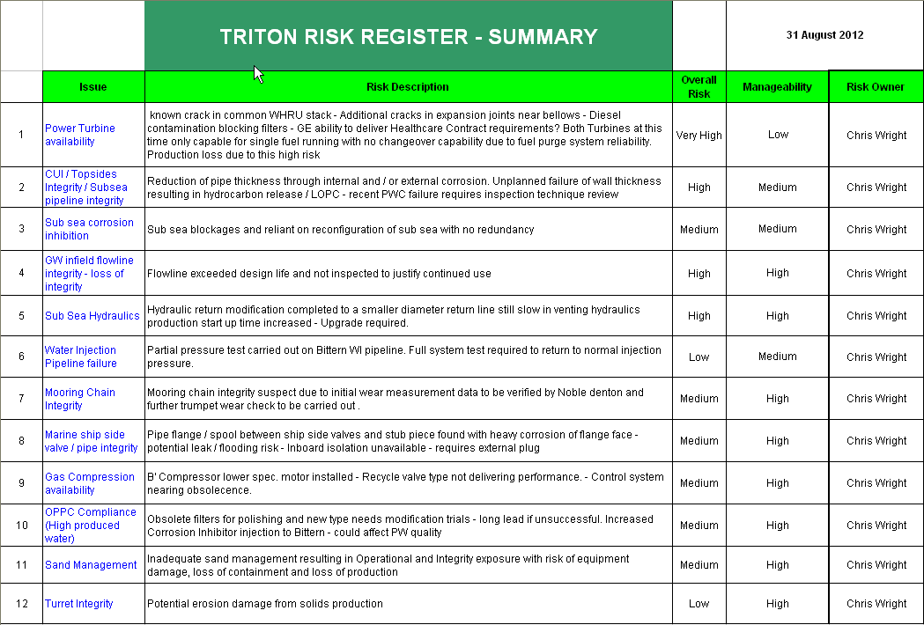
Sample risk register
December 30, 2023
Phil Collins
What’s missing from this risk register?
M. Rutherford
Tony Banks
Tony Banks
Tony Banks
Peter Gabriel
Peter Gabriel
Peter Gabriel
Phil Collins
Bob Geldof
Iggy Pop
Bob Zimmerman
17 April 2024

Slide 29
Develop risk register metrics
K P I
Key
Performance
Indicator
We don’t measure everything, just the main elements
We measure things that will make a difference and that we can affect
Measures are not absolutes they show trends
17 April 2024

Slide 30
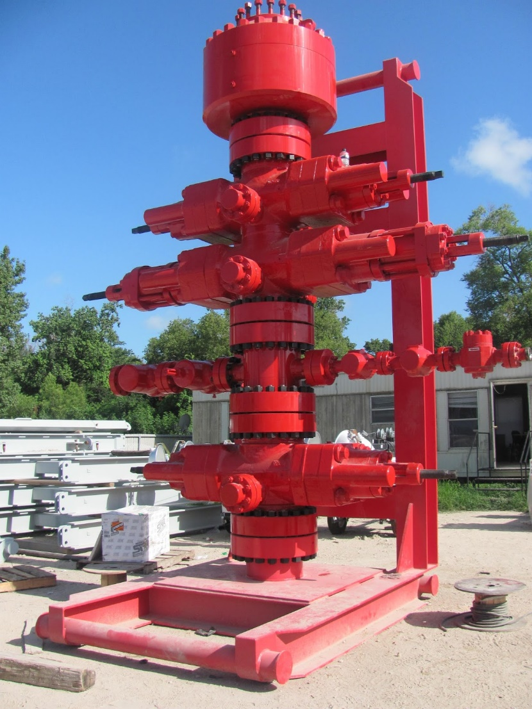
Risk controls
Are hazard controls (barriers) tested and verified?
Will they work when they are called upon?
How do you know?
Can you confidently say that “our assets our safe and we can show it?”
Mean Time To Failure rate for the entire BOP system is 48.1 days
Study by the American Bureau of Shipping and ABSG Consulting Inc. for the Bureau of Safety and Environmental Enforcement (BSEE), July 2013
17 April 2024

Slide 31
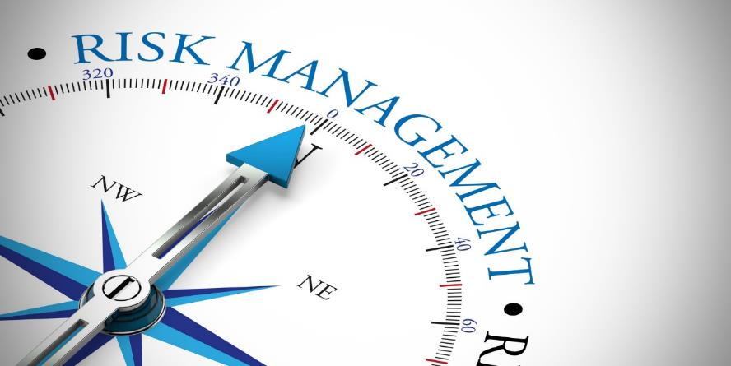
KPIs should answer questions
Do I know my risks?
Have I assigned accountabilities for my top risks?
Do I have actions and mitigations to my top risks?
Are the mitigations effective?
What’s been my actual experience?
Has anything changed that could introduce new risks?
17 April 2024

Slide 32

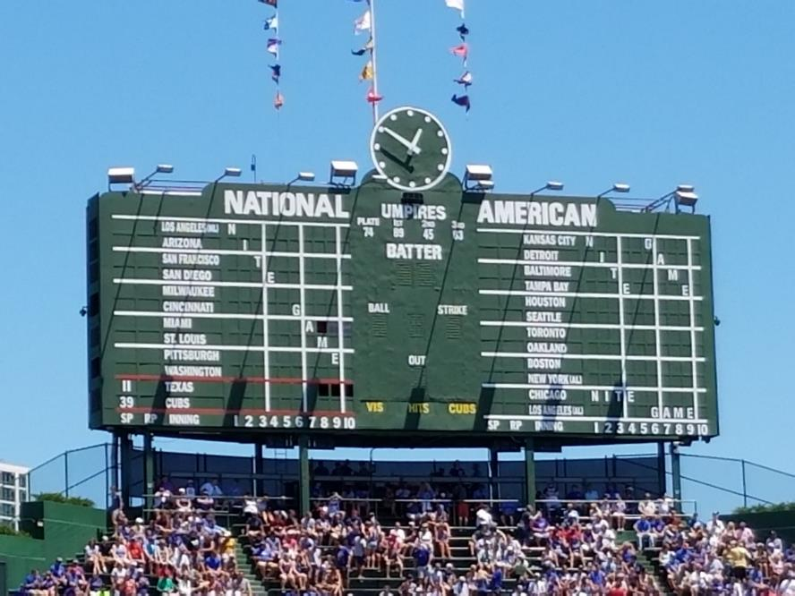
Sample scorecard
# | Item | Score Card
1 | Are business risks identified? (Matrix) |  | NO
2 | Have major risks have assigned accountability? (Register) |  | NO
3 | Do all major risk have approved mitigations? | %
4 | Have mitigations been reviewed for effectiveness? (Review) | %
5 | Have we completed an environmental scan and updated our business risk document?(Annual Process)
6 | Have we reevaluated our risk assessment based upon actual experience?
17 April 2024

Slide 33

OpEx andCapEx
How do you link the risk register to the budgeting process?
Risk owners should ensure sufficient funds to mitigate risks
Use the risk matrix to prioritize investments
Mitigate risk to ALARP (not zero)
Look for catalytic risk reduction opportunities
17 April 2024

Slide 34

Management review
What are the critical steps in the management review process?
Do we have the right information to evaluate our performance?
What’s was our actual vs. anticipated experience?
How effective were our assessment and mitigation approaches?
What are our employees seeing and experiencing?
Were our objectives met?
Are risk owners comfortable with their mitigations?
Has anything changed that could introduce new risks?
What do we need to document and revise?
17 April 2024

Slide 35
Diagnosing Your Current State of Risk Management
It is clear who owns enterprise risks.
We have the proper governance to manage enterprise risks.
We regularly identify and quantify risks.
The tools we use to assess risk are easy to understand.
We identify our major risks by using a risk matrix.
Management system elements and their associated risks have clear ownership.
Our capital planning process is clearly linked to our risk management approach.
Our executives annually review our risk management approach.
We have the right metrics in place to measure how well we manage risk.
17 April 2024

Slide 36

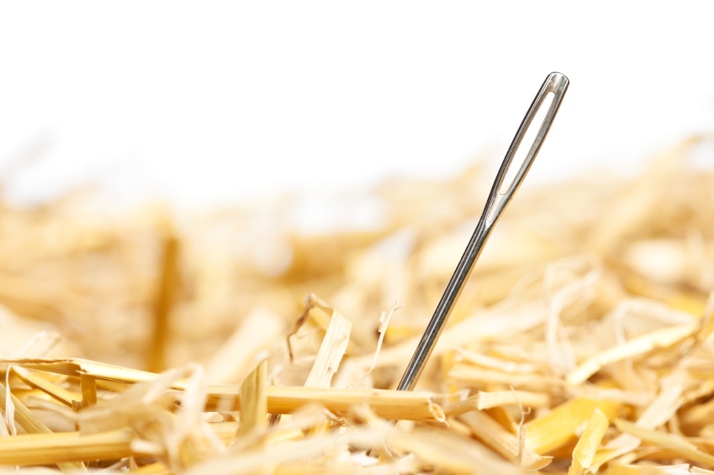
We often get risk wrong
Governance drives accountabilities
Risk matrices are helpful to understand and prioritize risk
Risk registers assign accountabilities
Management review keeps the process fresh and effective
Metrics allow you to answer important questions
Tie your budgeting process to risk mitigation activities
17 April 2024

Slide 37
Using Risk Registers To Drive Accountability
May 2, 2024
Larry Pearlman
President, Safety And Consulting Associates
Connect on LinkedIn
Email me for a copy of this presentation:
LPearlman@safetyand.ORG
17 April 2024

Slide 38

Risk culture self-reflection
“Risk is important. We look at it every time we have an incident”
“We have systems in place to manage all risks”
“We work on problems that we find. Risk leadership drives continuous improvement”
“Risk management is how we do business around here”
“Who cares as long as we’re not caught?”
Generative
Proactive
Calculative
Increasingly informed
Increasing trust and accountability
Reactive
We have a sense of chronic unease
Risk management is seen as a profit centre
Pathological
Risk leadership and values drive continuous improvement
Resources are available to fix things before an accident
We cracked it!
Lots and lots of audits
We are serious, but why don’t they do what they’re told?
You must consider the conditions under which we are working
The lawyers said it was OK
Sack the idiot who had the accident

