Slide 1
Are you in the “line of Fire?”
Case for Change

Slide 2
What is Line of Fire?
You are in the line of fire when you are at risk of coming into contact with a force your body cannot endure.
Line of fire is broken into three mechanisms of injury:
Stored Energy
Contact with stored energy
Includes pressure releases
Striking Hazards
Struck by or striking against an object
Includes dropped objects
Crushing Hazards
Caught in, on or between an object
Includes hand injuries

Slide 3
Current status?
Creating a company-wide line of fire program presents a significant opportunity for injury prevention.
Line of fire hazards, and the opportunity to correct them, are often overlooked.
Line of fire-related injuries are common and can lead to serious injury.
The line of fire program is aligned with Life Saving Rules and includes unsafe conditions as well.
Line of fire hazards exist year-round (not a seasonal trend).

Slide 4
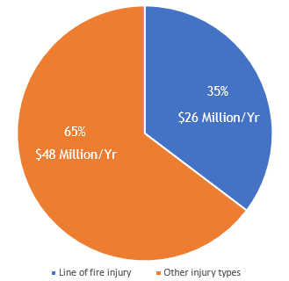
How Significant is Line of Fire?
Line of fire injury costs account for approximately 1/3 of all claim costs in the three western provinces with an annual cost of approximately $26 M. This is 8,514 people over the last five years that have been hurt.
8,514 People
*All Oil and Gas Funding Codes Western Provinces – 2014 to Q1 2019; includes injuries such as some fires and explosions, struck by vehicle, struck by objects, pressure releases, exposures to hazardous energy, caught in or crushed.

Slide 5
What Does our incident data indicate?
[Add your incident data and trends here:]

Slide 6
Alignment with Life Saving Rules
The line of fire program is aligned with Energy Safety Canada’s 10 Life Saving Rules, which focus on safe behaviours, however it can also stand alone.
The program also includes aspects relating to unsafe conditions and unsafe acts.
Unsafe Behaviors
Unsafe Behaviors
Unsafe Conditions

Slide 7
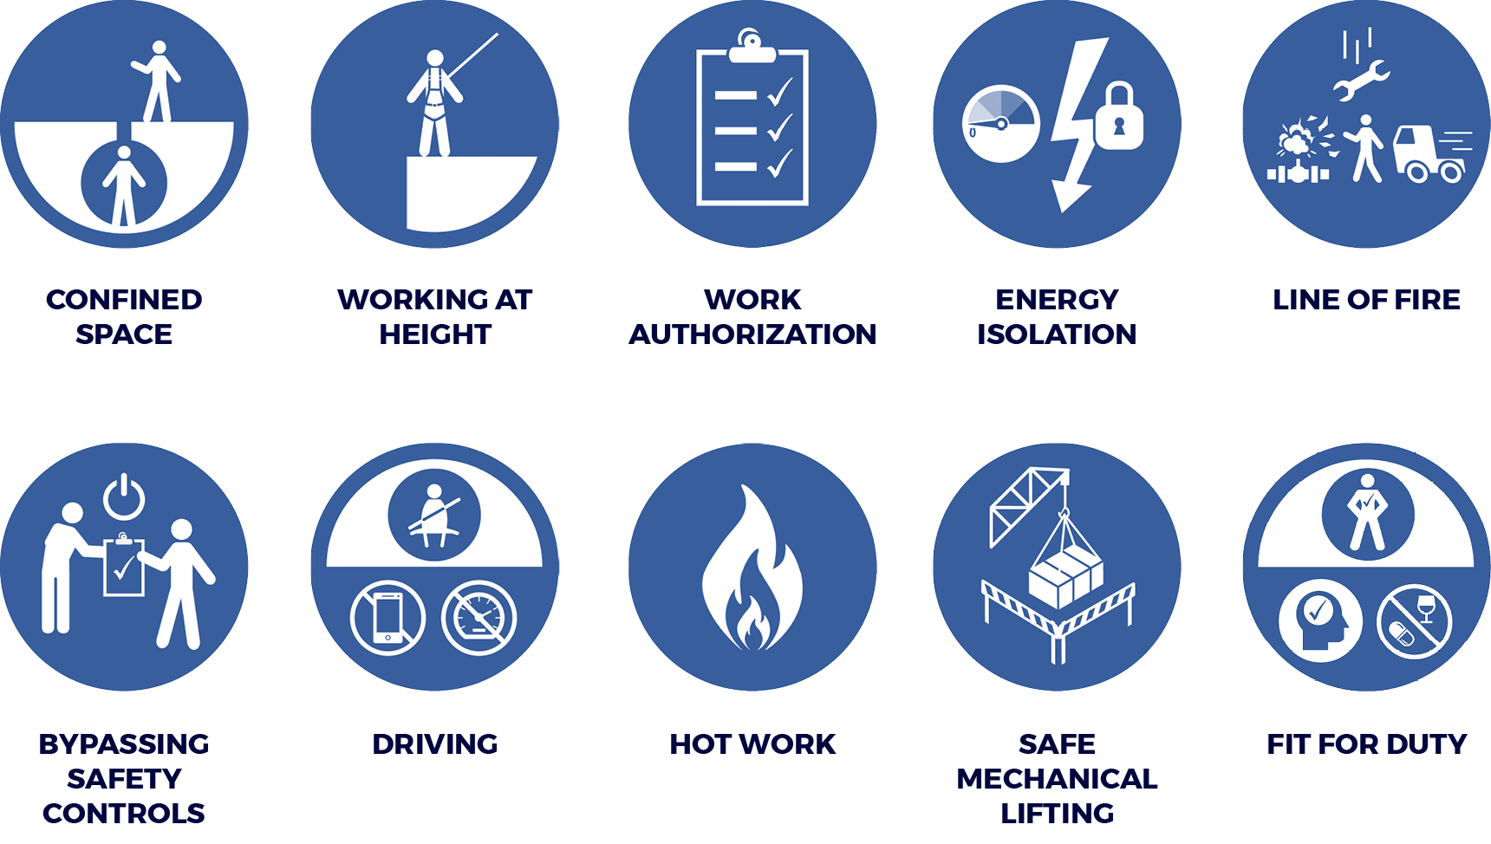
Energy Safety Canada’s 10 Life Saving Rules
NOTE: Nine rules were adopted from the International Association of Oil & Gas Producers (IOGP) with Fit for Duty being added to reflect the Canadian environment

Slide 8
Line of fire - Life Saving Rule
The Line of Fire Life Saving Rule has a large focus on body positioning.
Keep yourself and others out of the line of fire
I position myself to avoid:
Moving objects
Vehicles
Pressure releases
Dropped objects
I establish and obey barriers and exclusion zones
I take action to secure loose objects and report potential dropped objects
Notes:
Add in fit for duty and Energy Isolation

Slide 9
Jordan’s forklift became stuck in mud. A chain and sling was attached by site personnel to the ball of a pickup truck’s hitch while the other end was secured to the forklift. Jordan remained in the forklift while others took several runs with the truck to free the forklift. On the final pull, the explosive force of the shock load snapped the hitch ball off and sent it flying at Jordan. Jordan was struck on the head and died at the scene.
Jordan Roppel
Jordan Roppel was 18 and had less than two months on the job at a perforating shaped charge manufacturing plant in Standard, Alberta. Jordan was a vintage muscle car enthusiast and had plans to become an auto mechanic when he finished high school.
Line of Fire
The line of fire rule is designed to keep yourself and others out of the line of fire of moving objects like flying ball hitches.

Slide 10
Proposed goal
To reduce line of fire-related incidents company-wide, by 20% per year. This translates to [Insert company # here] fewer people being hurt.
The proposed program aligns strategically:
Supporting the company core values, including increased commitment to safety, respect, raising the bar, honouring commitments and doing the right thing.
Continue to advance our journey to zero injuries and zero incidents.
Continue to advance a strong safety culture through:
Working collaboratively to understand and manage line of fire risks
Building capacity in our people and systems to manage line of fire

Slide 11
Are you in the “line of fire?” program
Step 1:
Leadership alignment
Level of effort
Resourcing
Budget
Implementation
Next steps:
Flexible focused program
Activity packages
Company webpage and social media

Slide 12
Step 1: leadership alignment
Leadership Engagement
H&S works with leadership to assist with appropriate level of effort recommendation for their specific areas.
Functional area leadership team meetings
Functional Area Level of Effort Identification
Review draft level of effort and agree on upcoming years program
Functional Area Resource Allocation
Identify functional area sponsor and communicate expectations.
Identify functional area leaders.
Scheduled H&S to conduct orientation in partnership with the functional area leaders, sponsor(s), and/or champions.
Material Ordered
Identify material needs and order (https://escsafety.devcogroup.com/)
Distribute materials

Slide 13
Next steps: focused program
Activity Packages
Functional area leaders use activity packages to help roll out the program.
Packages include Toolbox Talks, Inspections, Forms, etc.
Communications
H&S rolls out program on existing employee communication channels (i.e. internal website)
Communications include: company website, social media (Twitter, Facebook etc.)

Slide 14
Initial questions for leadership
Consider:
Do you want to participate?
To what degree?
Who will be the sponsor and the supporting leaders?

Slide 15
Program implementation: Functional Area breakdown
Line of Fire Program Components | Smaller Location | Larger Location | Our Location
Case for change | ? hour(s) | ? hour(s) | ? hour(s)
Posters and tent cards | ? hour(s) | ? hour(s) | ? hour(s)
Activity package delivery | ? hour(s) | ? hour(s) | ? hour(s)
Activity package issue follow-up and Resolution | ? hour(s) | ? hour(s) | ? hour(s)
Hazard hunts | ? hour(s) | ? hour(s) | ? hour(s)
Hazard signage | ? hour(s) | ? hour(s) | ? hour(s)
Inspections | ? hour(s) | ? hour(s) | ? hour(s)
Total Hours | ? hour(s) | ? hour(s) | ? hour(s)

Slide 16
Leadership engagement
Time Line
1. | Meeting with ESC | Date TBD
2. | Case for change presentation | Date TBD
3. | H&S check-in | Date TBD
4. | Functional area leadership team presentation | Date TBD
5. | Program final review & sign off by key H&S leaders | Date TBD
6. | Program implementation | Date TBD

Slide 17
Planning, design and release
Time Line
1. | Development of project execution plan | Date TBD
2. | Secure resources | Date TBD
3. | Informal lessons learned | Date TBD
4. | Project development work | Date TBD
5. | Minor tweaks and/or final deliverables | Date TBD
6. | Awareness training for H&S | Date TBD
7. | Program final review and sign off by functional area leaders | Date TBD
8. | Monitor and support roll out | Date TBD

Slide 18
Optimum program rollout schedule
Time Line
1. | Leadership engagement Identify level of effort Identify resources Order materials | Date TBD
2. | Awareness training for H&S, Comms and key stakeholders | Date TBD
3. | Program implementation | Date TBD
4. | Activity package 1 | Date TBD
5. | Activity package 2 | Date TBD
6. | Activity package 3 | Date TBD

Slide 19
Roles and Responsibilities overview
H&S Team
Functional Area H&S Team
Functional Area Leadership Team and Sponsor
Functional Area Leaders
Ensure the Line of Fire program is maintained and improved yearly based on post-event lessons learned.
Act as a subject matter expert to support the functional area H&S team.
Provides a sample “starter kit” of materials to all functional area participating.
Hosts the campaign page on the company website and social media.
Co-host an orientation session in partnership with the functional area sponsor/s, H&S, communications specialist(s).
Work with functional areas to provide ongoing statistics and lessons learned.
Provide feedback on the program to Energy Safety Canada.
Review last year’s lessons learned and identify opportunities for improvement.
Conduct a review to draft upcoming years level of effort proposal.
Act as a local subject matter expert to support the functional area champions.
Provide program direction and works closely with functional area champion to prepare them to run the program.
Plan and schedule orientation session in partnership with the H&S team.
Provides ongoing statistical analysis of workplace injuries.
Provide feedback on the program to H&S team.
Review the draft level of effort and agree on upcoming years program.
Leadership team identifies functional area sponsor and communicates expectations.
Leadership team identifies functional area champion(s) and communicates expectations.
Provide ongoing stewardship of resource utilization, program success and challenges, associated work orders and/or corrective actions.
Work with H&S team to plan and schedule an orientation session in partnership with the H&S team.
Identify tactical material needs.
Lead roll out within their specific area.
Work with the function area sponsor to escalate issues or highlight opportunities.
Provide regular feedback to the functional area sponsor on progress.
Customize supporting campaign material
Work with the functional area team to act as an area subject matter expert.
Provide ongoing feedback on the program to functional area H&S team.
Notes:
ESC to update

